Slide 1
Building a Circuit

Slide 2
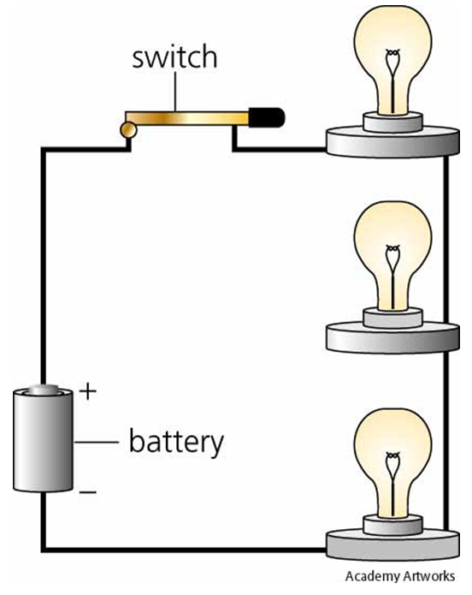
Parts of a Circuit
Source – battery, outlet, generator etc.
Path – wires
Load – converts electrical energy into another kind. Ex. Light bulb, kettle, motor

Slide 3
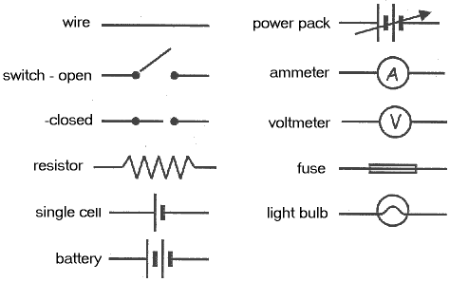
Schematics

Slide 4
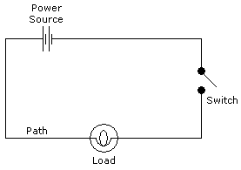
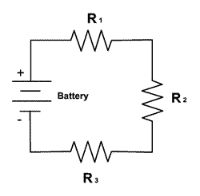
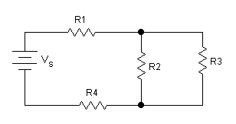
Examples

Slide 5
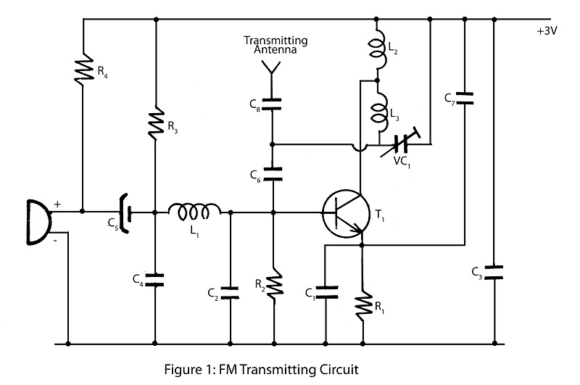
Advanced Example

Slide 6
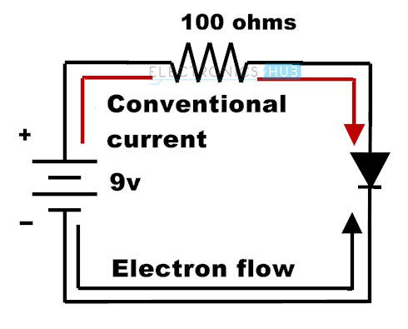
Electron Flow vs Conventional Current
Conventional current (positive flow) was used before it was known that electrons (not protons) are the charged particles moving through a circuit. It is still used today.

