Slide 1
Electric Potential Difference

Slide 2
What is an Electrochemical Cell?
A cell is a device that uses chemical reactions to produce electric potential energy
A battery is made of 2 or more cells
The battery was invented by Alessandro Volta

Slide 3
How does it work?
A simple cell consists of 2 rods called electrodes, which are immersed in an electrolyte (conducting fluid)
+ = cathode
- = anode

Slide 4
How does it work?
A chemical reaction between the electrodes and electrolyte causes one electrode to gain electrons and the other to lose electrons, giving each a different charge, and causing a potential difference between the electrodes -> Voltage

Slide 5
Electric Potential Difference
When a charge is moved from one point to another, an electric potential difference is created.
An electron will leave the –ve terminal with more energy than when it returns to the +ve terminal

Slide 6
Electric Potential Difference
This potential difference is the Voltage of the cell.
1 Volt is the amount of energy (J) to move 1 C between two points.

Slide 7
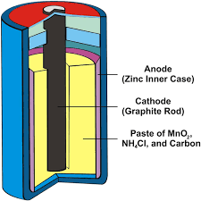
Types of cells
Different cells use different materials for electrodes and electrolytes
1. Dry Cell
uses an electrolyte made from paste
Most common householde batteries
Safer than liquid cells
2. Liquid Cell
Use a liquid electrolyte (sulfuric acid)
Ex. Car batteries

Slide 8
Types of Cells
3. Primary Cell – Non rechargeable
4. Secondary Cell - rechargeable

