Slide 1
Biodiversity and Endangered Species

Slide 2
Food Chains and Food Webs
Food chains are the feeding relationships that link organisms together. Generally, producers are eaten by herbivores which are eaten by carnivores.
Food webs are many connected chains.
Ecological pyramids characterize how the number of organisms at each trophic level decreases as one moves along the food chains.

Slide 3
Tertiary Consumer
(omnivore/carnivore)
Secondary Consumer (omnivore/carnivore)
Producer
Primary consumer
(herbivore)
Decomposers
(ex: Fungi)
Each section is a new
Trophic level
Energy is lost as we move
up trophic levels
Energy Flow

Slide 4
What is Biodiversity?
Biodiversity is the variety of living organisms in a particular habitat habitat or geographic area.
Biodiversity is usually measured as the number of species or subspecies of plants, animals, and micro organisms. Biodiversity contributes to an ecosystem’s sustainability.

Slide 5
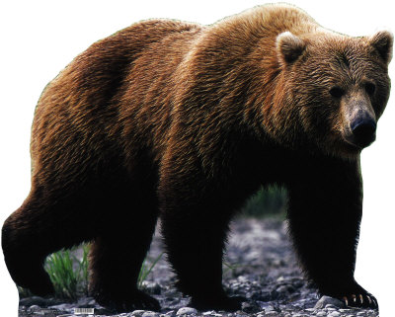
What happens if there’s less diversity?
Extirpated species: Species that no longer exist in a particular area, but can be found in others.
Ex: Grizzly Bears

Slide 6
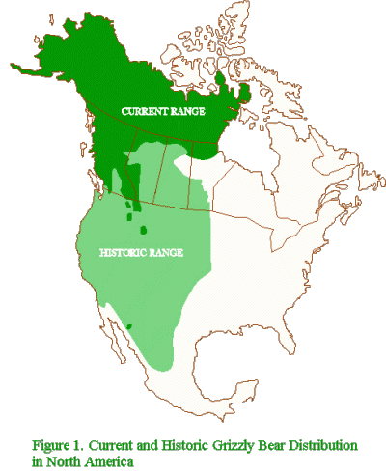
Did you know that the state
Animal of California is the Grizzly
Bear?
Interesting fact for a place that has
NO Grizzly Bears!
The last bear recorded was in 1922

Slide 7
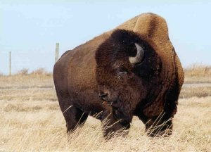
Threatened Species: Species that is likely to become endangered if factors that make it vulnerable are not reversed.
Ex: Bison

Slide 8
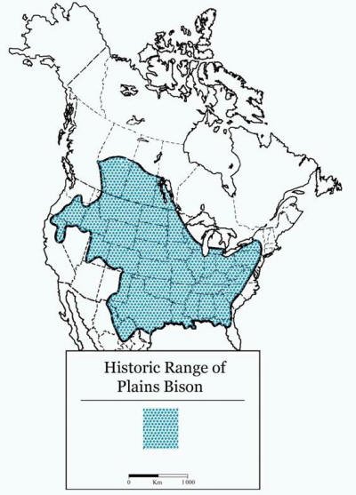
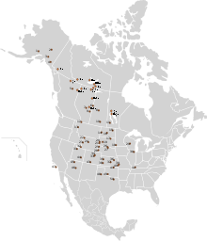
Is Manitoba the next California?

Slide 9
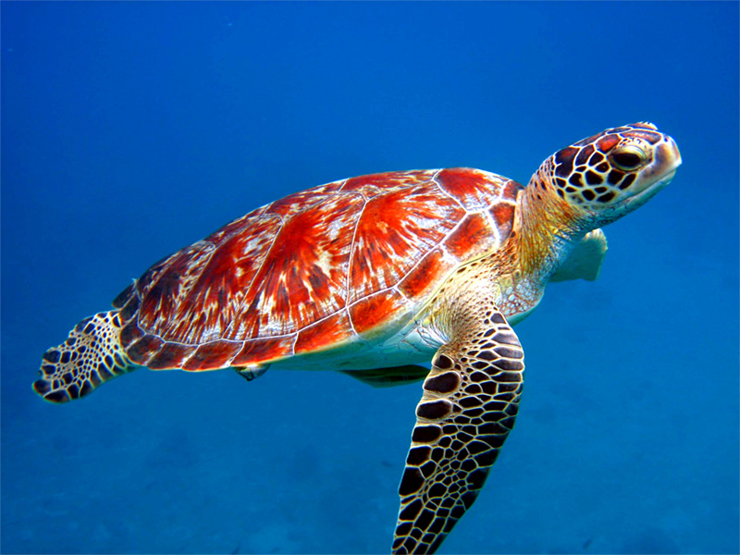
Endangered species: Species that is close to extinction in a significantly large location.
Ex: Marine Turtles
Three of the the seven species of
marine turtles are on the endangered
species list

Slide 10
InVasive and Exotic species

Slide 11
What is are exotic and invasive species?
Exotic species are organisms that are non-native to a specific environment.
So.. A moose would be considered exotic in the rainforest just as monkeys are considered exotic in Manitoba
An invasive species, is an exotic organism that is disrupting the biodiversity of a particular environment.

Slide 12
BRAINSTORM!
How many exotic species can you think of that live in Manitoba? (besides the animals living in the zoo..)

Slide 13
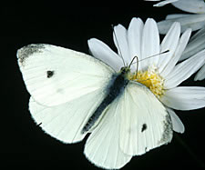
Were these on your list?
White tailed deer
Small mouth bass
Horses
Cows
Earthworms
Rainbow trout
Wild turkeys
Pigeons
Cabbage white butterfly

Slide 14
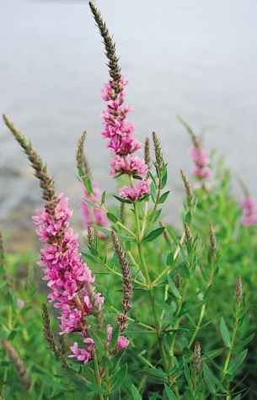
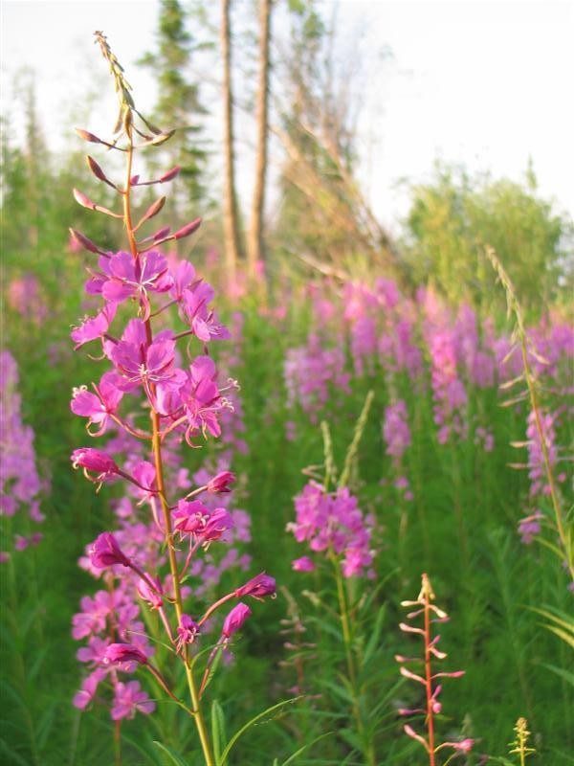
Which one doesn’t belong? (In Manitoba)

Slide 15
Invasive Species
Invasive species – if they are able to survive in their new environment - often lack predators, but have plenty of food so their populations grow rapidly.
Adding an invasive species to an already stable food web can cause a lot of damage in a short period of time.
http://www.invasivespeciesmanitoba.com/site/index.php?page=zebra-mussels

Slide 16
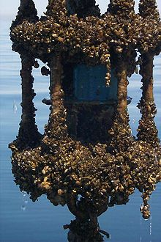
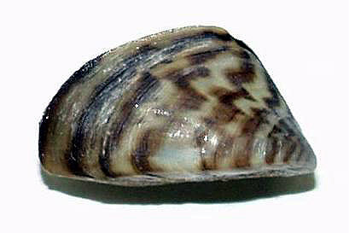
What can you do?
Know your invasive species!
For invasive aquatic species it is important to thoroughly wash your boat and trailer before traveling.
Report any invasive species that you come across to Manitoba Conservation

Slide 17
You Decide!
Considering everything we know about ecology…. Are humans an invasive species??

