Slide 1
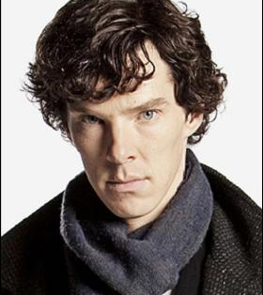
Forensic Science
I never guess. It is a shocking habit—destructive to the logical faculty. What seems strange to you is only so because you do not follow my train of thought or observe the small facts upon which large inferences may depend. - Sherlock Holmes

Slide 2
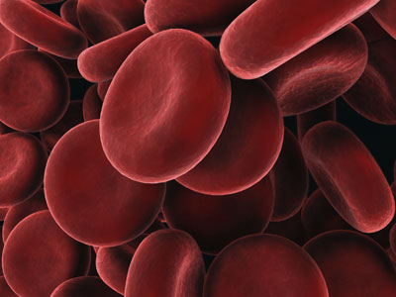
Blood

Slide 3
Blood Trivia…
How much blood is in your body?

Slide 4
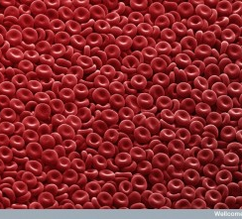
What is blood made of?
Red Blood Cells
1 mL has 5-6 million red blood cells
Use hemoglobin to transport oxygen

Slide 5
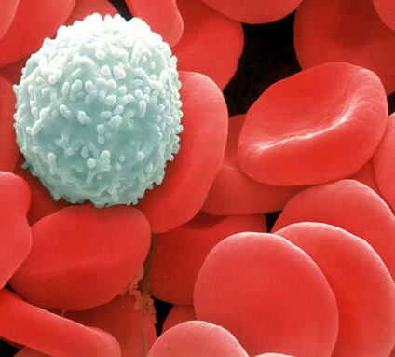
What is blood made of?
White Blood Cells
Fight infection

Slide 6
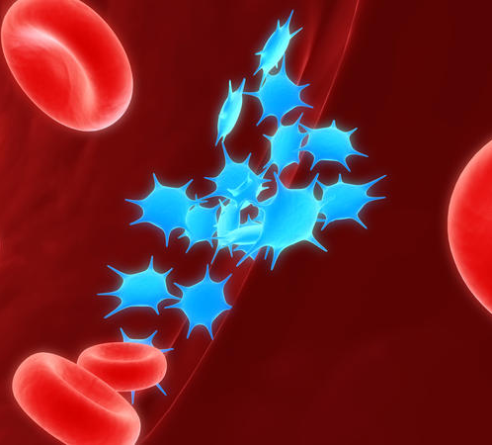
What is blood made of?
Platelets
Helps blood to clot

Slide 7
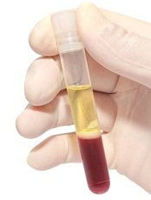
What is blood made of?
Plasma
90% water
Fluid part of blood
Carries everything

Slide 8
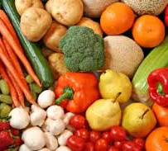
What is blood made of?
Chemicals
Proteins, sugars, fats, salts, enzymes, gases

Slide 9
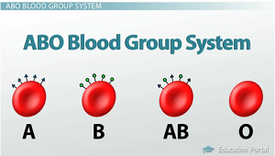
Blood Type – There are 4 ABO Blood Types

Slide 10
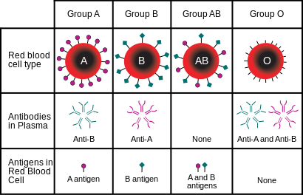

Slide 11
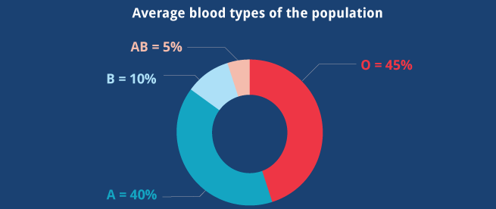
Blood Type

Slide 12
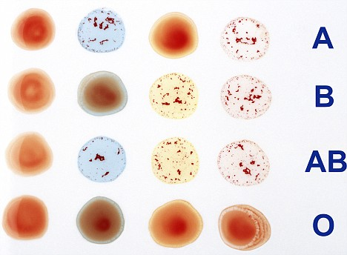
Mixing Blood
Blood types must be matched efore a transfusion can take place, or the blood can clump which can be fatal.

Slide 13
Mixing Blood

Slide 14
Mixing Blood
Type A cannot receive blood with B antigens
Type B cannot receive blood with A antigens
Type AB can receive any blood (universal receiver)
Type O cannot receive blood with ANY antigens
*It is still best to receive blood that matches your type

Slide 15
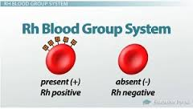
Rh Factor
The Rh Factor is another antigen that is either present or absent on red blood cells.
Rh Positive – have the antigen
Rh Negative – don’t have the antigen

