Slide 1
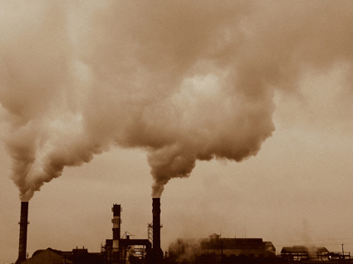
Chemical pollution

Slide 2
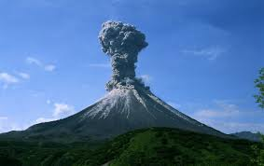
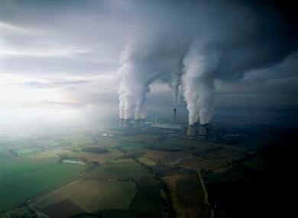
Air Pollutants
Natural: forest fires, volcanoes, decay of vegetation
Human: burning forests and waste, burning fossil fuels

Slide 3
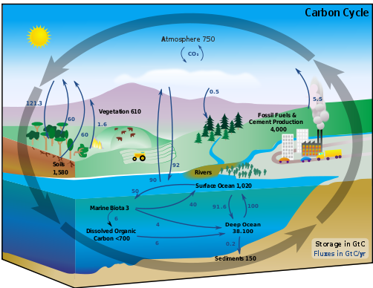
Carbon Dioxide
Carbon dioxide is naturally produced by all living creatures, including plants

Slide 4
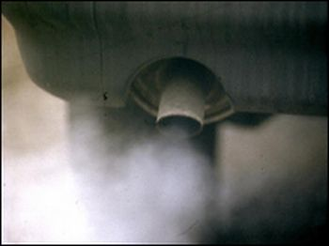
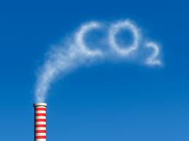
Carbon Dioxide
Carbon dioxide is also produced by automobiles and industries.
One car produces three and a half times its weight every year in carbon dioxide emissions.
So much carbon dioxide is being produced that there is growing concern over its contribution to the greenhouse effect and global warming.

Slide 5
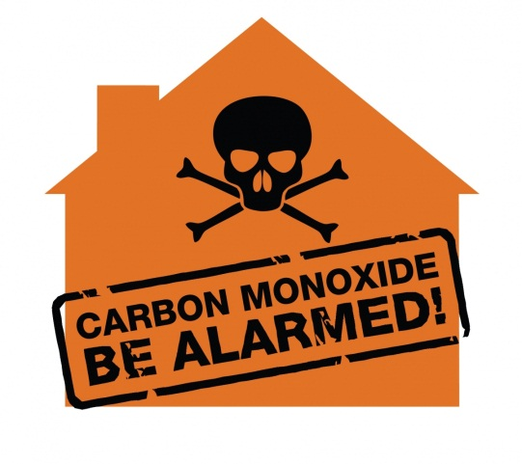
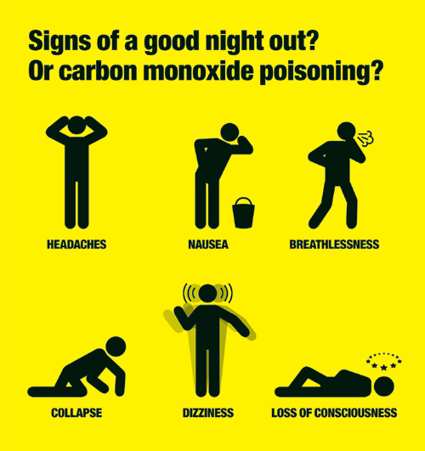
Carbon Monoxide
Odourless, invisible gas – undetectable by humans
Makes people feel sleepy, cause headaches, can cause death
Produced when fuel is not completely burned

Slide 6
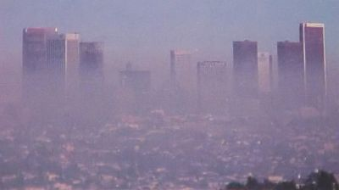
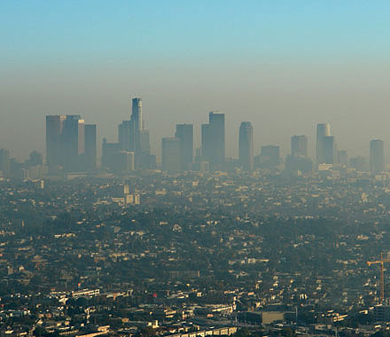
Nitrogen Oxides
Cause brownish haze (smog) in large cities when gas is present in high concentration with no means to disperse
Contribute to acid precipitation by creating nitric acid when in contact with water
Produced when fuels burn at high temperatures

Slide 7
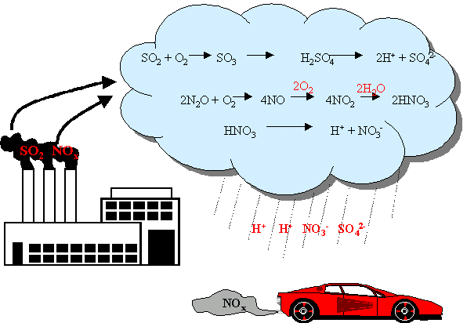
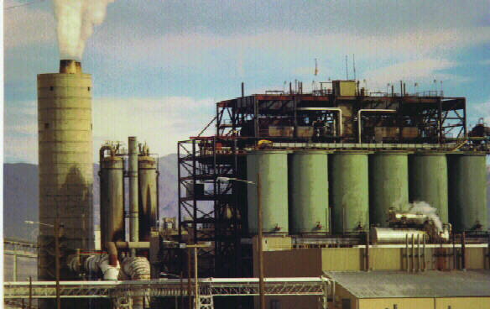
Sulfur Oxides
Main cause of acid precipitation
Combine with water to form sulfuric acid
Produced when sulfur containing coal or ore is burned or smelted

Slide 8
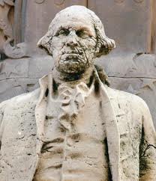
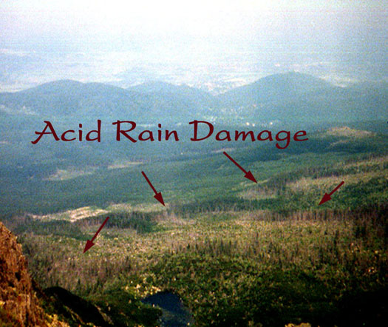
Acid Precipitation
Describes any precipitation with a pH of less than 5.6
Main causes are sulfur oxides and nitrogen oxides
Acid precipitation does over $1 billion damage each year in Canada alone!!
Fact: Acid rain with a pH of 2.4 fell during a storm in New England. That’s the same pH as vinegar!!

Slide 9
Hydrocarbons
Substances contained in solvents, oil based paints, and fossil fuels
Cause breathing problems such as asthma

