Slide 1
Chromatography

Slide 2
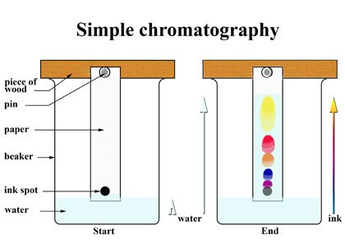
Chromatography
An ancient method used to separate parts of a mixture
Black ink is a mixture of several colours which can be separated during chromatography

Slide 3
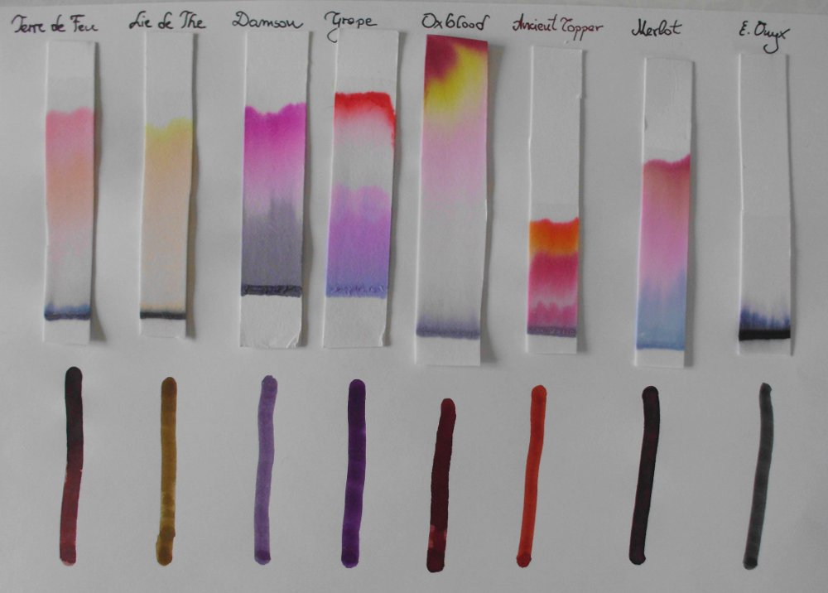
Chromatography
Each ink produces a unique banding pattern when absorbed through a solvent called a chromatograph
Components that are more soluble in a solvent appear further at the top, components that are less soluble appear at the bottom

Slide 4
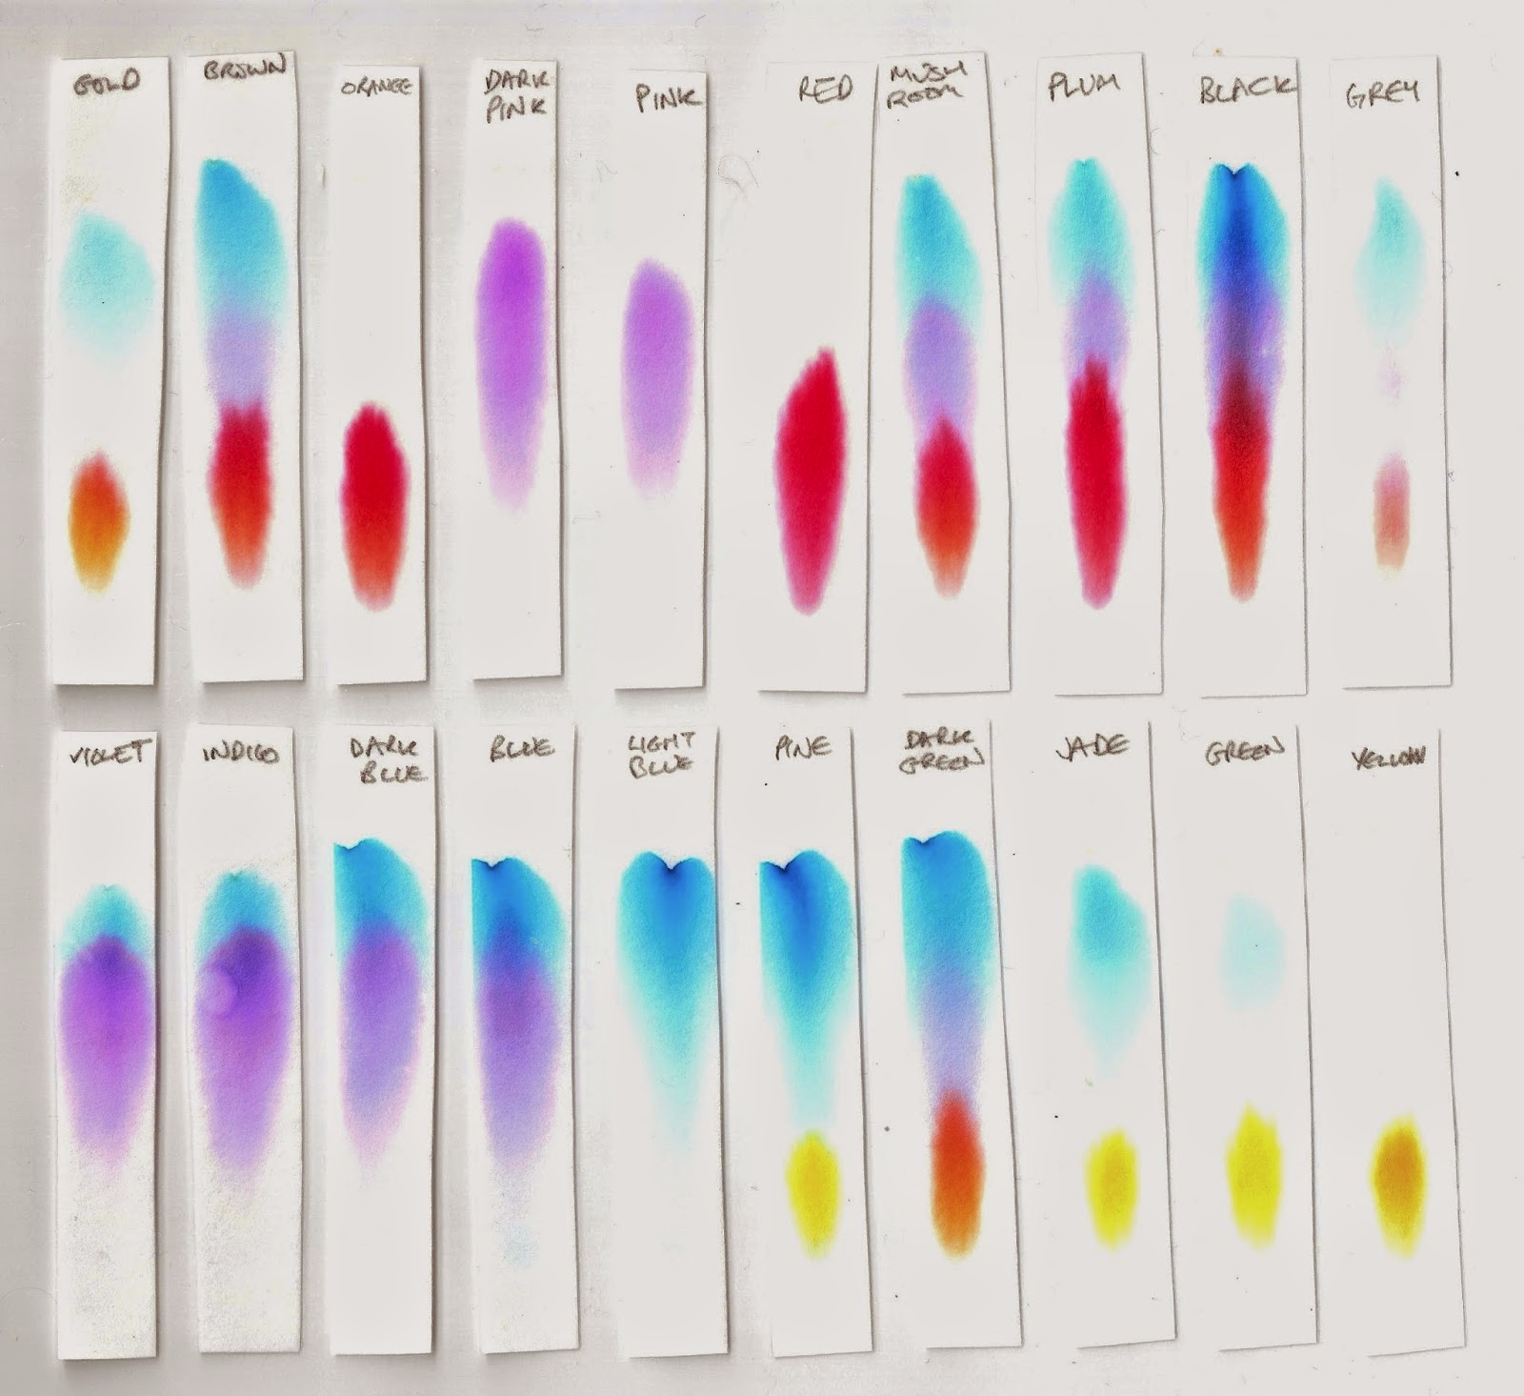
Chromatography
A chromatograph can be used to identify the type of ink used to write a note at a crime scene.

