Slide 1
Circular Motion

Slide 2
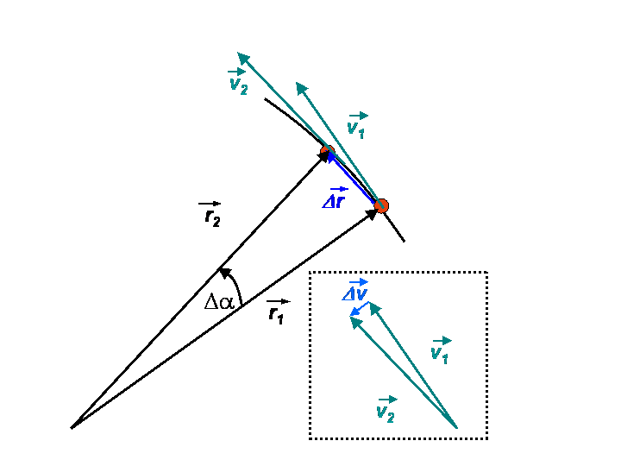
What is acceleration????
Change in velocity
Look at the direction of Δv
The direction of the change in velocity is toward the center!!

Slide 3
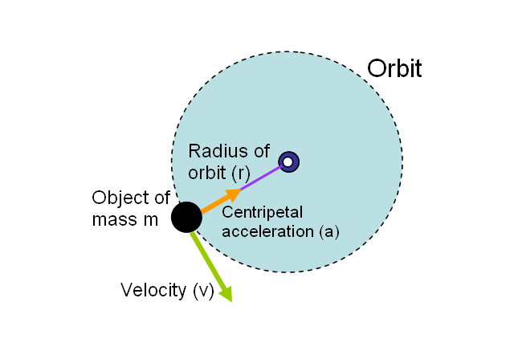
Centripetal Force
Acceleration is caused by a force – centripetal force
Biggest lie in physics: centrifugal force!!! (artificial gravity)

Slide 4
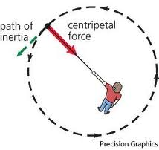
Some definitions…
Rotation – turning on axis
Revolution – turning around axis
Tangential speed – m/s
Rotational speed – rpm rps

