Slide 1
Decomposition
How do forensic investigators determine time of death?

Slide 2
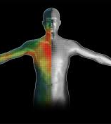
Body Temperature
Body cools approximately 1 to 1.5 degrees per hour
Rate of cooling depends on environment, body fat, clothing, and drugs

Slide 3
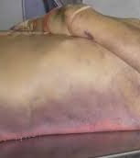
Livor Mortis (discoloration)
Blood settles to lowest parts of body due to gravity
Appears 1-2 hours after death, fixed within 8-10 hours

Slide 4
Rigor Mortis
Muscles stiffen 15 min after death and lasts 36 hours

Slide 5
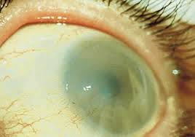
Clouding of Eyes
Due to potassium build-up
Occurs in 2-3 hours if eyes are open, 24 hours if eyes are closed

Slide 6
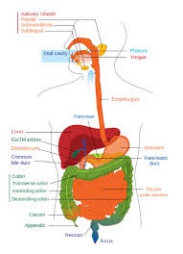
Rate of Food Digestion
Takes 4-6 hours depending on food, metabolism, drugs, emotional condition, exercise

Slide 7
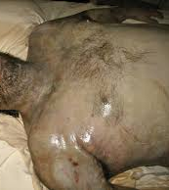
Decay and Decomposition
Paling of skin
Flattening of eyes
Extremities turn blue
Mucous membranes dry out
Swelling and rotting of body as bacteria spread

Slide 8
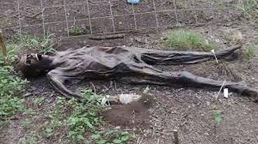
Decay and Decomposition
Blackening of skin
Bloating, blistering, peeling of skin
Liquefaction of organs
Loosening of teeth, hair, nails

Slide 9
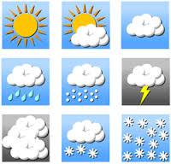
This process is affected by:
Weather
Warm and humid conditions: body decomposes to a skeleton in a few weeks
Cold: can take years
Hot and dry: body might mummify

Slide 10
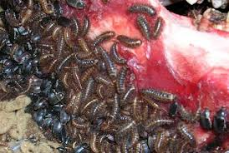
Scavengers
Insects arrive in stages, feed on, and change the body
Blowflies lay eggs (within minutes)
Maggots feed on decaying tissue
Flies and beetles feed directly on the corpse
Wasps, spiders, and predators of flies feed on the insects present

Slide 11
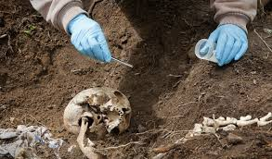
Scavengers
By observing the species and developmental stage of organisms present, scientists can determine TOD
Sometimes guts of insects are used to get DNA samples!

