Slide 1
DNA and Chromosomes

Slide 2
DNA
Deoxyribonucleic Acid
Stores all our genetic information

Slide 3
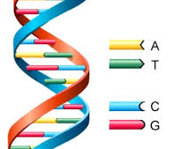
DNA
Shaped like a double helix
Blueprint for making all the cells in your body

Slide 4
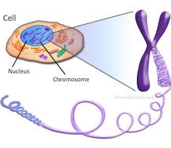
Chromosomes
Store all the DNA in your cells
Cells contain a nucleus, nucleus contains chromosomes, chromosomes contain DNA

Slide 5
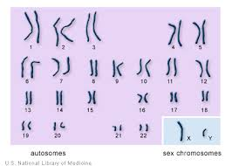
Chromosomes
All of your chromosomes come from your mom and dad, so you get half of your DNA from each parent.

