Slide 1
DNA Part 2

Slide 2
KWL

Slide 3
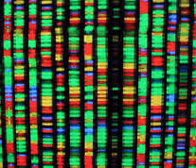
DNA Part 2
The total genetic information for an organism is called a genome.
The coding in your DNA is divided into sections called genes.
Genes are the fundamental unit of heredity, they determine how you grow and develop, and what you look like. Examples: eye color, muscles…
Thousands of genes are found in one chromosome.

Slide 4
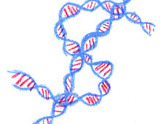
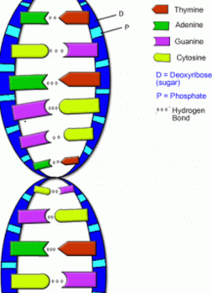
Structure of DNA
Double Helix
Closer look…

Slide 5
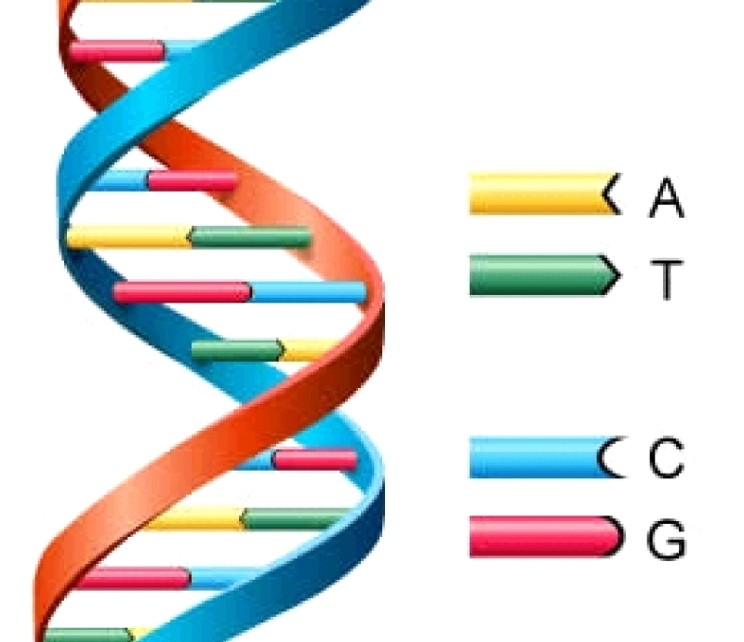
Structure of DNA
Each DNA molecule is made of:
Phosphate Group
Sugar
Nucleotide
Adenine
Cytosine
Guanine
Thymine

Slide 6
Structure of DNA
All people have the same DNA structure, but the order of nucleotide pairs in a gene determine your characteristics, and the order can be different for each person!

Slide 7
DNA Fingerprinting
Forensic investigators can collect DNA samples from : blood, semen, body tissues, hair, or saliva, to see if they match a suspect.
The samples must be purified and multiplied so they can be used for testing.
Enzymes are used to break strands of DNA apart at certain sequences. Now you have a whole bunch of pieces of DNA of different lengths.

Slide 8
DNA Fingerprinting
The pieces of DNA are put into a gel which is electrically charged. Since the DNA has a negative charge, it moves to the positive end.. Shorter pieces move faster, longer pieces move slower.
As the DNA pieces move, they make a banding pattern that is stained and can be seen with UV light.
Since each sample has DNA of different lengths, each banding pattern will be unique. The pattern can be matched to one from a crime scene the same way we match fingerprints.

Slide 9
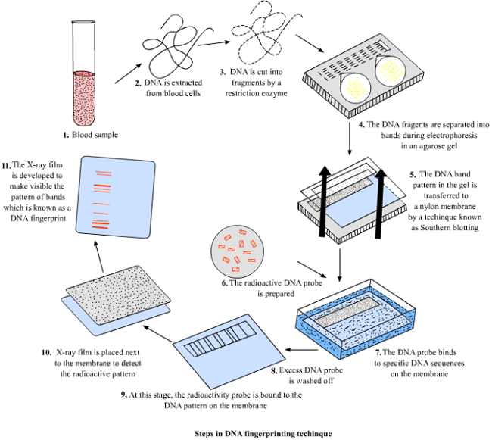
DNA Fingerprinting

Slide 10
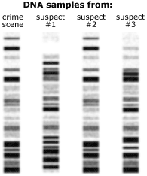
DNA Fingerprinting

