Slide 1
Dynamics of Circular Motion

Slide 2
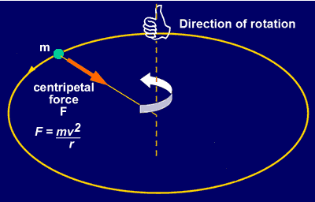
Free Body Diagrams

Slide 3
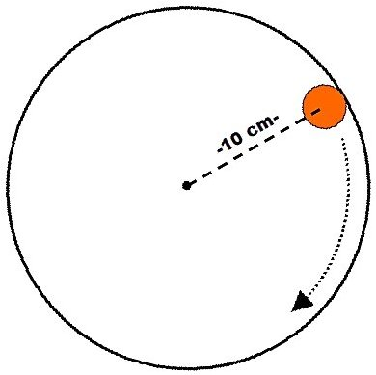
Free Body Diagrams

Slide 4
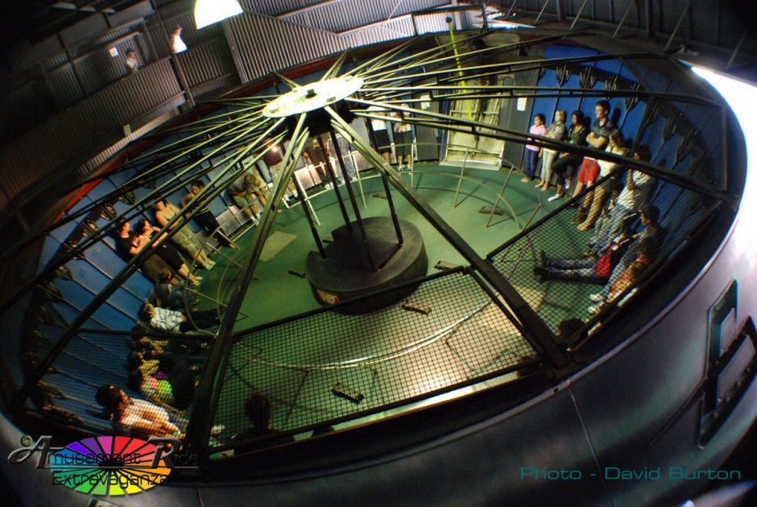
Free Body Diagrams

Slide 5
More F_{net}
Centripetal force is another name for net force in circular motion. It is the sum of the forces acting towards the center.
F_{net} = ma

