Slide 1
Elastic and inelastic collisions

Slide 2
Elastic Collisions
One object transfers ALL its energy to the other
Energy is conserved
Momentum is conserved
Ex. Billiard balls

Slide 3
Inelastic Collisions
One object only partially transfers its energy to the other.
Energy is lost
Momentum is conserved.
Ex. Pillow fight

Slide 4
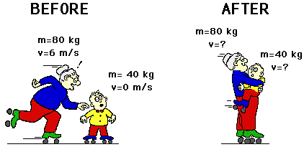
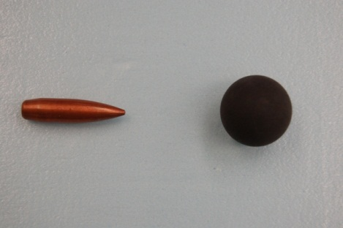
Completely Inelastic Collisions
Two objects stick together after impact.
Energy is lost
Momentum is conserved
Ex. Bullet hitting target

Slide 5
Note: Momentum is always conserved!!!!

