Slide 1
ENGINEERING DEFINITIONS

Slide 2
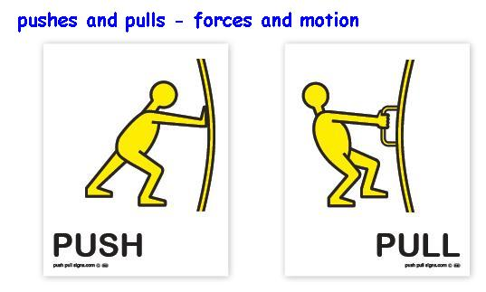
Force

Slide 3
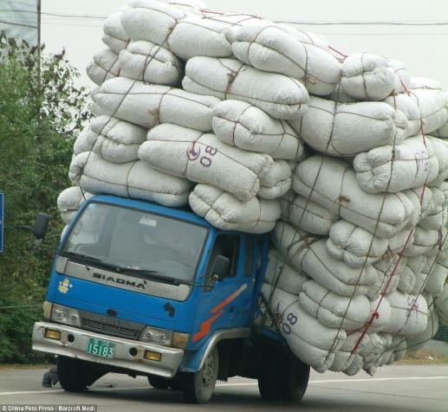
Loads

Slide 4
Compression

Slide 5
Tension

Slide 6
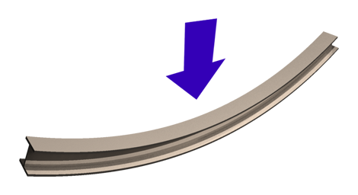
Bending

Slide 7
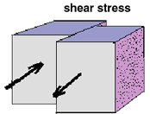
Shear

Slide 8
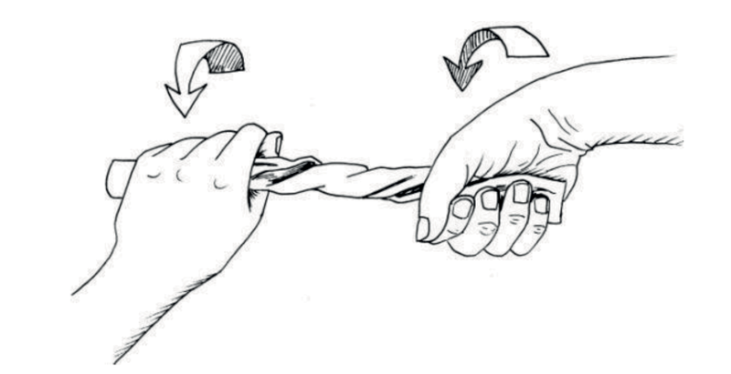
Twist

Slide 9
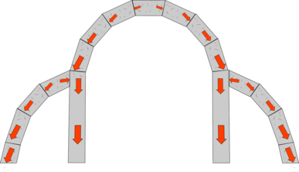
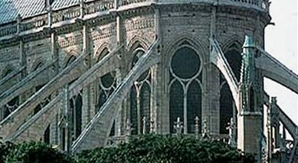
Arch and Buttress

Slide 10
Dome

Slide 11
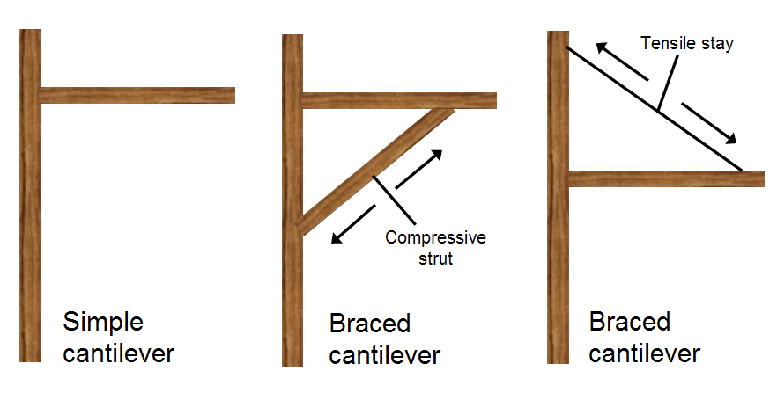
Cantilever

Slide 12
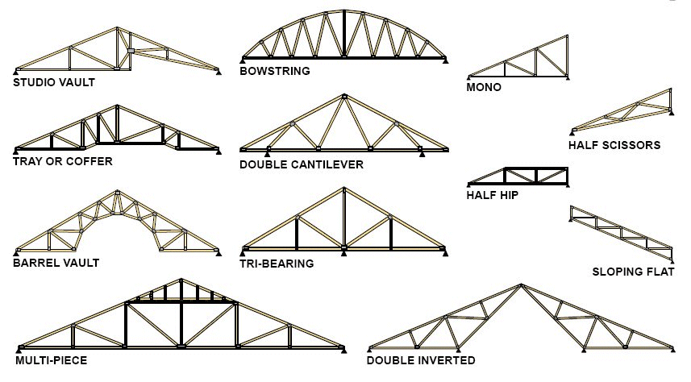
Truss

