Slide 1
Fingerprinting

Slide 2
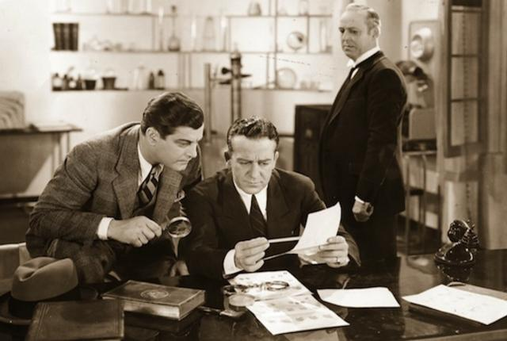
History
1400’s – a doctor discovered that no two sets of fingerprints are exactly the same
Fingerprints never change, no matter how old you get

Slide 3
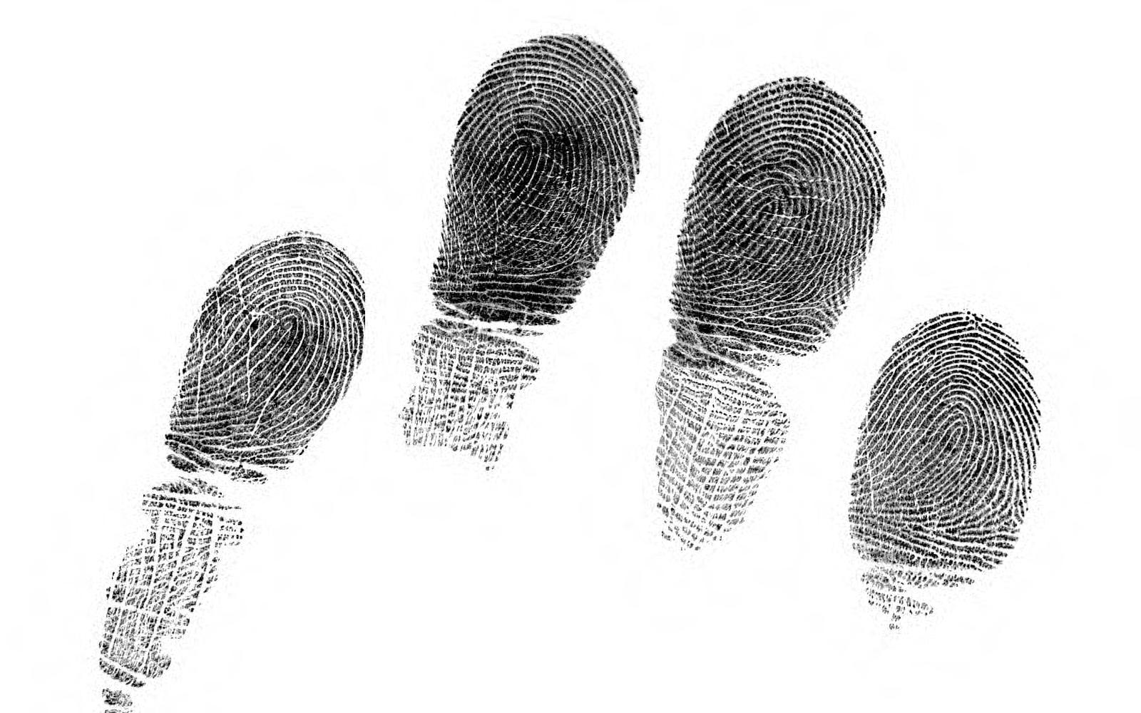
Why do we have fingerprints?
They help with grip!
Hands and feet have ‘friction ridges’ that make it easier to hold on to objects

Slide 4
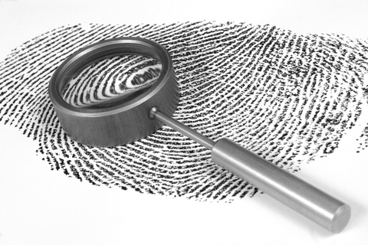
Why do we leave prints?
Tiny glands in between friction ridges secrete sweat and grease
When you touch and object, the grease and sweat from the ridges sticks to it creating a latent print
A dusting powder can be used to make the latent print visible

Slide 5
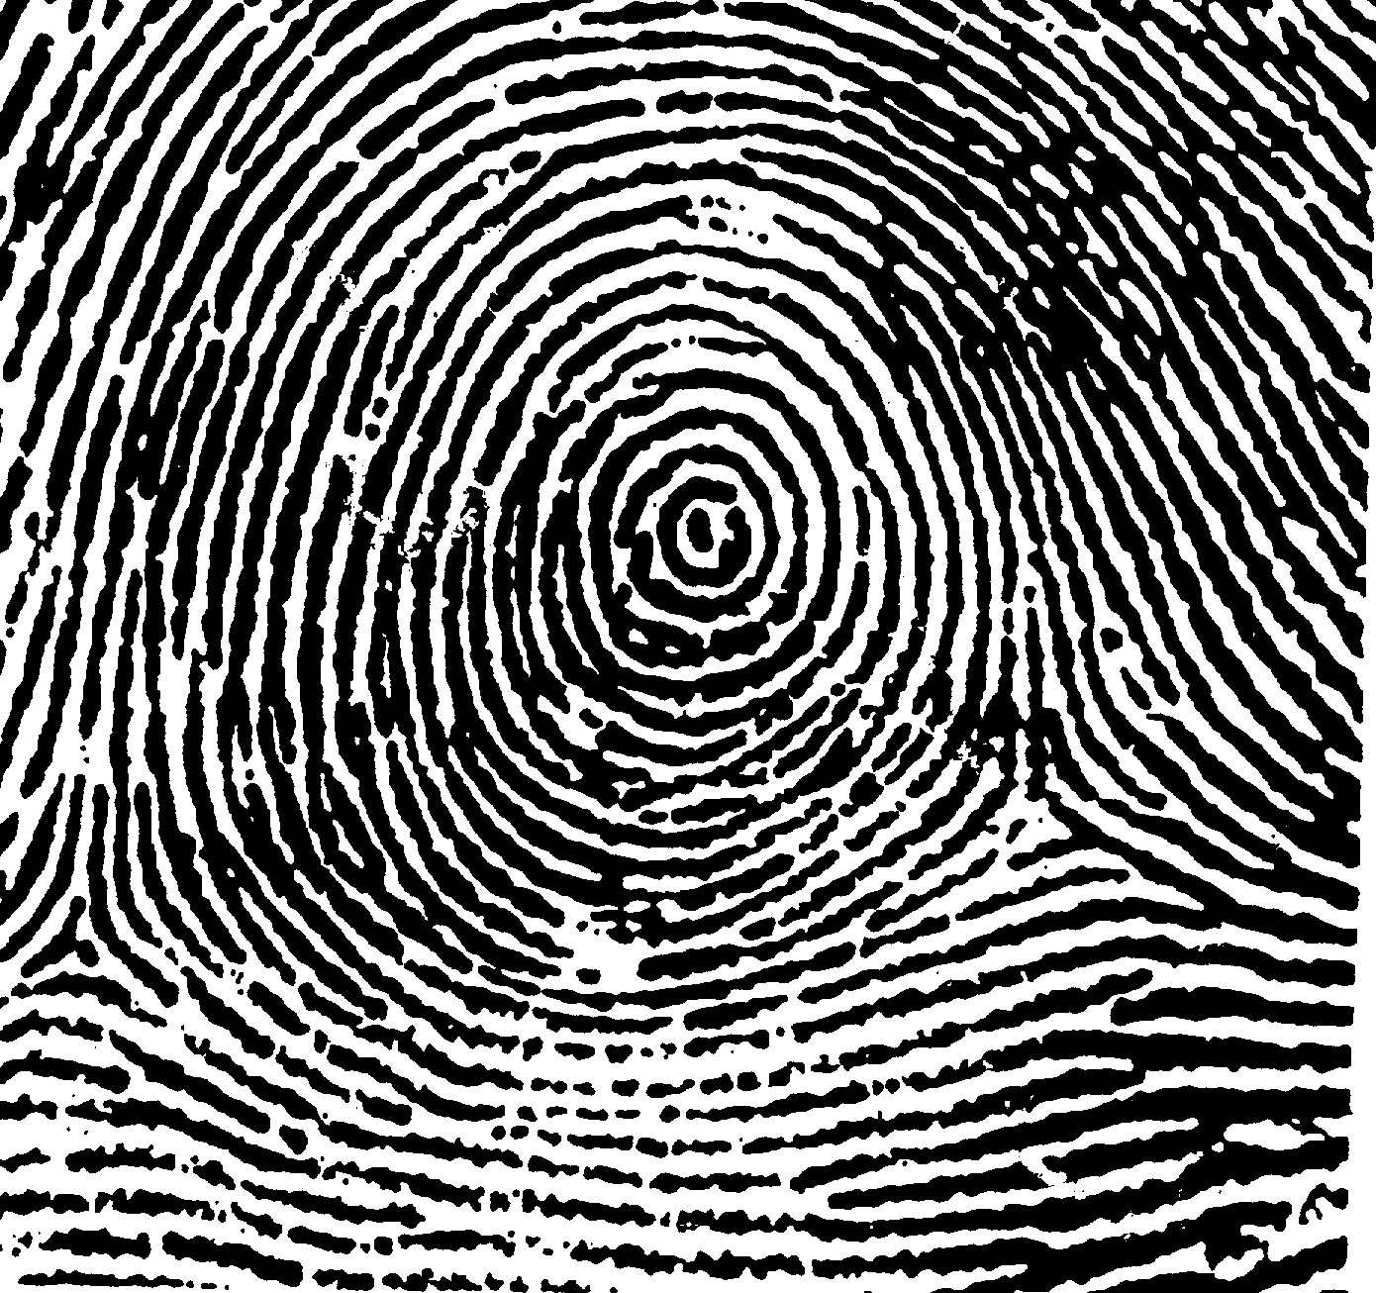
Types of prints: whorl
Like a bulls eye

Slide 6
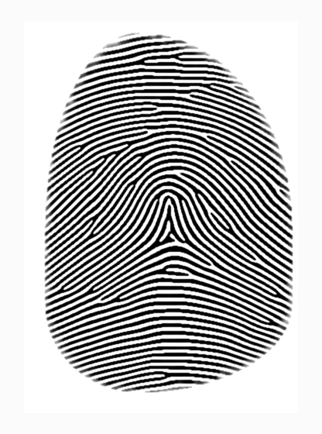
arches
Like a hill

Slide 7
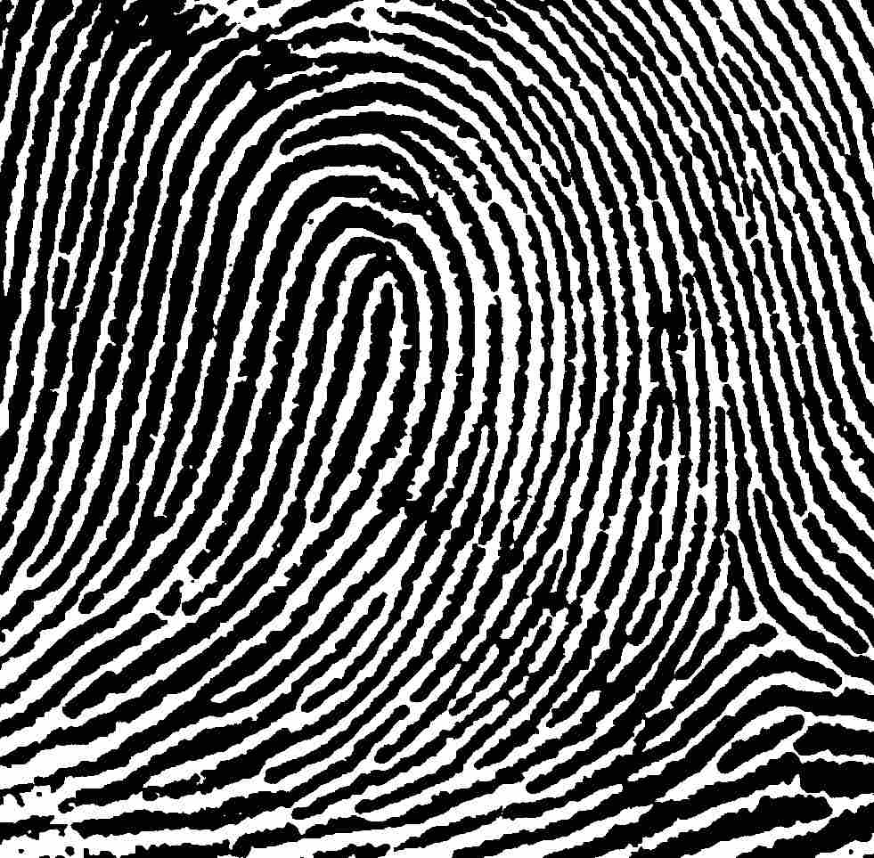
loop
Like an upsidedown U that curves to one side

Slide 8
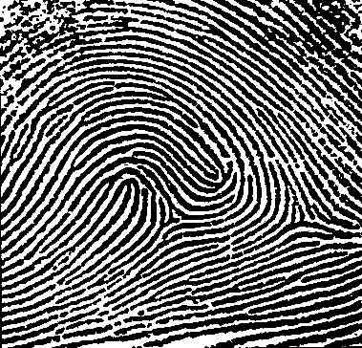
accidental
Combination of other 3 patterns

