Slide 1
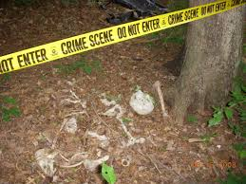
Forensic Anthropology

Slide 2
Forensic Anthropology
https://www.youtube.com/watch?v=3zqZPujAPuc
It is the study of skeletal and other human remains in order to identify an individual and determine the circumstances involved in the death of the individual.

Slide 3
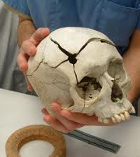
What can we know from a skeleton?
Age
Gender
Ancestry/ Race
Stature/ Height
Unique features

Slide 4
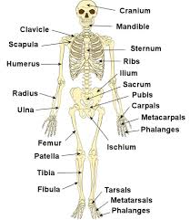
Osteology – the study of bones
Forensic anthropologists must be experts at identifying bones because sometimes that’s all that is left of a body!
The human body has 206 bones.
The average skeleton weighs 10-12 lbs, 3-4 kg

Slide 5
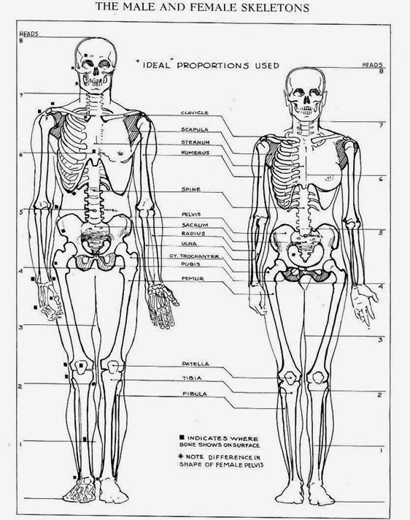
1. Gender
Males:
Narrow pelvis
Square chin
Larger canines
Pronounced area of muscle attachment on cheekbone
Extreme nose bridge
Sloping forehead

Slide 6
1. Gender
Females:
Wider pelvis
Rounder chin
Slight nose bridge
Straight forhead

Slide 7
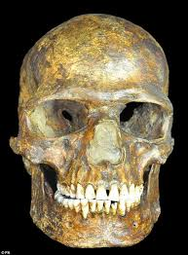
2. Age
Calcification (bones fusing together) More calcification for older skeleton
Changes in pelvis
Evidence of arthritis
Worn teeth

Slide 8
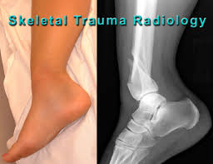
3. Previous Trauma
Broken bones can be compared to hospital records
Can be used to determine cause of death

Slide 9
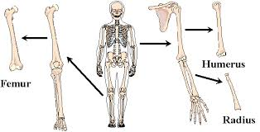
4. Height
If the skeleton is incomplete, the height can be approximated by measuring the length of the foot (or other bones)

Slide 10
4. Height
The foot represents approximately 15% of your height
There are different ratios for other bones as well
There are different ratios for children
Example…

