Slide 1
Fundamental Forces

Slide 3
Strong Nuclear Force
Holds protons together in the nucleus
Strongest of all fundamental forces
Very short range!!!

Slide 4
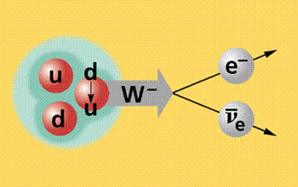
Weak Nuclear Force
Changes the flavour of quarks to allow for a proton to become a neutron

Slide 5
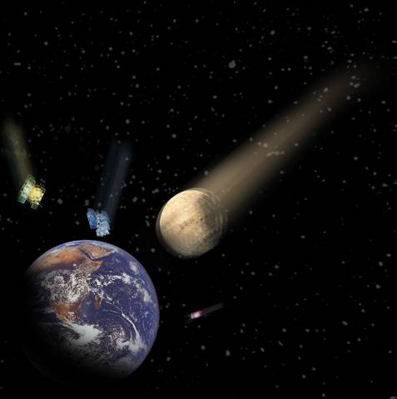
Gravitational Force
Attractive force due to mass
Follows the inverse square law, so has infinite range

Slide 6
Electromagnetic Force
Attractive and repulsive force between charges and moving charges
Follows the inverse square law, so has infinite range

Slide 7
http://www.youtube.com/watch?v=Yv3EMq2Dgq8&safe=active

