Slide 1
Handwriting analysis

Slide 2
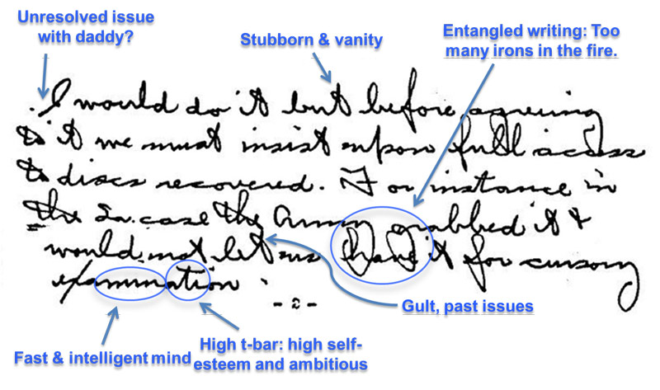
Handwriting analysis involves the study of shapes, forms, and inconsistencies. When attempting to identify a particular handwriting, just as in fingerprinting, a forensic scientist will examine a combination of characteristics. She will examine the way the lines form letters, the slant (forward, backward or straight up and sown), spacing, and ornamentation (dotting of I’s and crossing of t’s). Forensic investigators also use psycholinguistic analysis to carefully examine a person’s choice of words, their spelling, punctuation and grammar, in written (and spoken) communication.

Slide 3
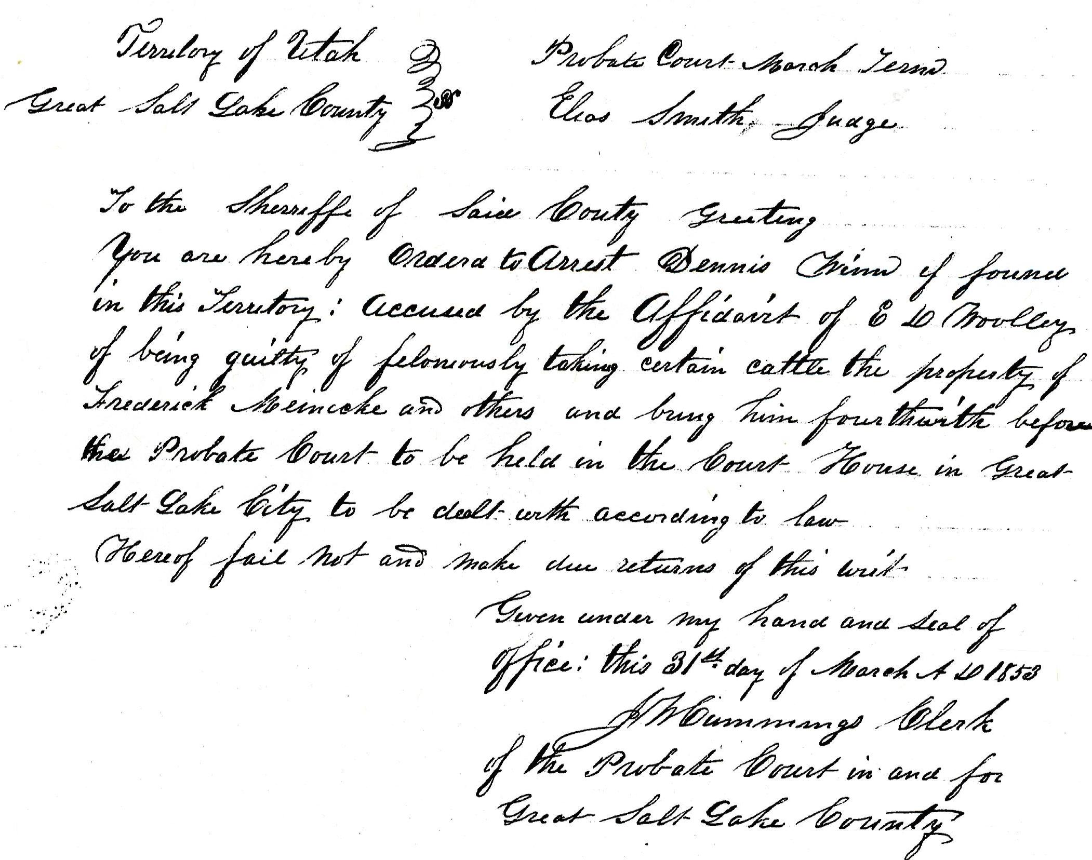
When making handwriting comparisons, the forensic scientist will attempt to obtain an exemplar or sample of the person’s handwriting. The scientist may have the individual re-create the document, using the same writing tool and paper, and dictating composition at varying speeds and emphasis.

Slide 4
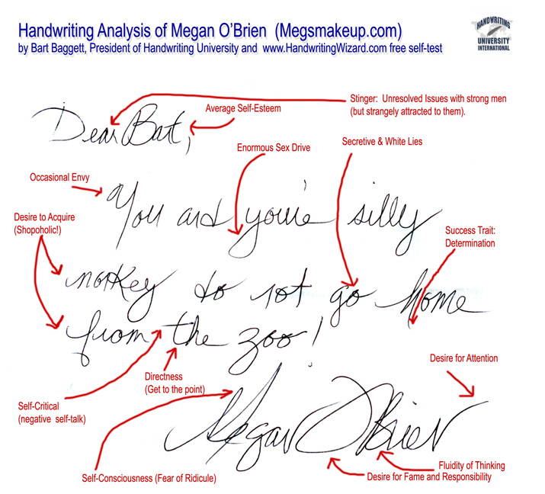
The scientist may also obtain writing samples by searching through an individual’s effects. Handwriting analysts maintain that lying results in slight physiological changes that might affect the slant, pressure, or spacing in writing. Many times when someone tries to disguise their style of writing they write faster than normal, are deliberately careless, or write smaller or larger then they normally do.

Slide 5

They may also try to change the slant of their writing. They may print instead of write, or they may change the hand they write with. If the forensic scientist has enough handwriting samples from the suspect, she c an usually determine whether or not the suspect has written certain documents.

Slide 6
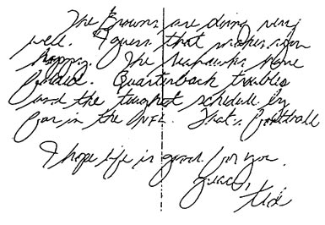
Somewhat subjective, handwriting analysis is not a science, and handwriting analysts are often not accepted as expert witnesses in trials.

