Slide 1
John Snow
Controlling Environmental Conditions to stop the spread of disease

Slide 2
Environment
Physical surroundings of the hosts
Altitude, climate, geography, dust, sunlight, season of year, time of day

Slide 3
John Snow
The first person to use scientific methods to identify the environment in which a disease was spreading.

Slide 4
Cholera
Terrible disease caused by a bacteria.
Infected people have diarrhea so badly that they get dehydrated.
Within 2 or 3 days nearly half the patients will die.

Slide 5
Cholera
1854 – cholera outbreak in the SOHO section of London
According to a local doctor, “the most terrible outbreak of cholera which ever occurred in the kingdom.”
In a single night, doctors reported 56 new cases of cholera – all within a few blocks.
Nearly 500 people lost their lives.

Slide 6
Cholera
Many people and scientists believed cholera was spreading through infected air called miasma.
John Snow believed that it might be spreading through contaminated water.

Slide 7
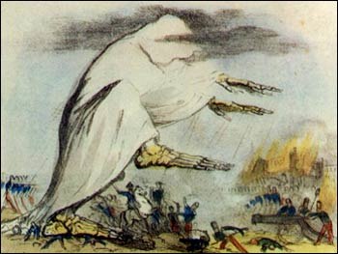
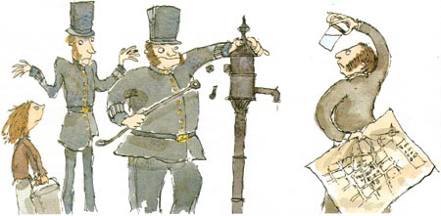
Table Group Activity
Group A - Water
Group B - Air

Slide 8
John Snow’s Map
John Snow mapped the area showing where all the people who got sick or died lived.
He also mapped the pumps people used for getting their water supply.
Deduced that all the people who got sick collected water from a particular pump

Slide 9
John Snow’s Map
Two women who died lived many miles away, but Snow learned they had drunk water from the pump.
Some people who lived in the area had not gotten sick, but Snow learned they got their water from other sources.

Slide 10
John Snow’s Solution
Snow believed that cholera was spreading by water that had been contaminated by sewage.
After sharing his findings, he had the handle of the pump removed and the outbreak ceased.

Slide 11
Putting it together…
Well was 28 feet deep
Sewer was only 22 feet deep
People remembered a bad smell from the well a few days before.
As more people got sick the water became more contaminated.

