Slide 1
Law of conservation of mass

Slide 2
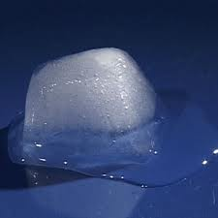
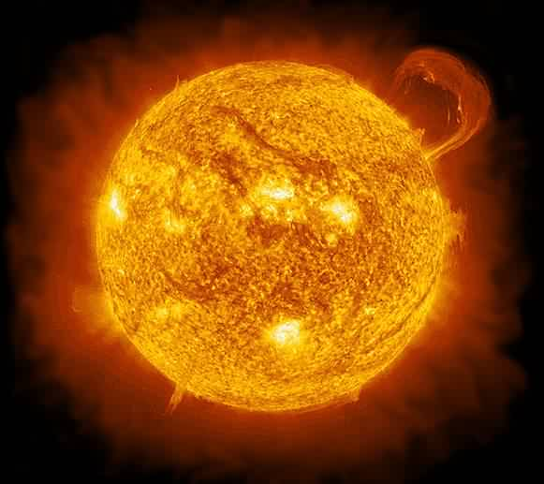
Physical vs Chemical Change
Physical
Chemical

Slide 3
Physical vs Chemical Change
Physical
Chemical
Melting
Freezing
Changing shape (crumpling, breaking, squishing, stretching…)
Heat
Light
Bubbles/ smoke
Colour change
precipitate

Slide 4
Physical vs Chemical Change
Physical
Chemical
Reversible
Substance stays the same
Permanent
New substance produced

Slide 5
Conservation of matter
Matter cannot be created or destroyed, it only changes form.
In both physical and chemical changes, the total mass before is equal to the total mass after.

