Slide 1
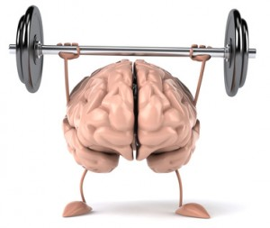
Mental Game

Slide 2
Discuss the following statement:
Success in athletics depends just as much on mental abilities as on physical abilities.

Slide 3
Discuss the following statement:
The athlete who wins is always happier than the athlete who loses.

Slide 4
Discuss the following statement:
When 2 players have equal physical ability, the one with the stronger mind will win.

Slide 5
Discuss the following statement:
An angry coach helps athletes perform better.

Slide 6
Rate the following in order of importance for an athlete:
Motivation
Ability to set goals
Relaxed responses to stress
Ability to focus

Slide 7
Visualization
Athletes mentally rehearse a certain
Movement
Routine
Relaxed response to crisis

Slide 8
Visualization
How?
20 min/day
Conjure up how you feel when you do something well
Imagine the moves of a great athlete
Include every detail (ex sounds, feelings). The more real you make it, the more powerful it is.

Slide 9
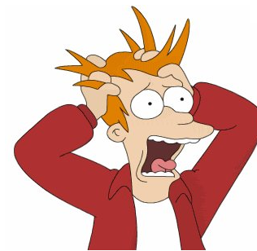
Relaxation
Stress can reduce performance by causing blank-outs, fumbles, quitting, or fatigue

Slide 10
How to stay relaxed:
Mental preparation helps athletes overcome stress (ex eliminate negative emotions during fall, fans, losing)
Reduce importance of event
Listen to music
Talk

Slide 11
Psych-out
Players try to intimidate their opponents with
Appearance/ expression
Logos, tattoos
Trash talk (try to get opponent to lose focus or attack you)

Slide 12
Superstition
Examples from pros:
Eating chicken
4 hour pregame routine
Spouse can’t wear certain color on race day
Tapping things with racket/ bat/ ball
Not washing socks during winning streak (29 games)
Sprinkling rice on pitchers mound
Wearing old uniforms

Slide 13
Superstition
More examples from pros…
Stay in locker room till a particular player burps
Tap goalies shins with stich before game
Not stepping on chalk lines

Slide 14
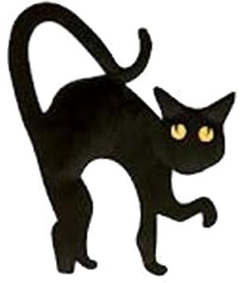
Where do superstitions come from?
Childhood (ex step on a crack…)
Ancient times (bathing washes away good luck)

Slide 15
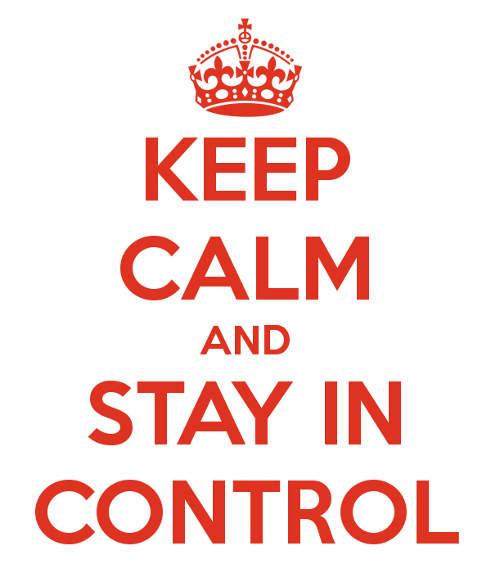
Why do people have superstitions?
Feel like they are in control
Have an edge over tough odds

Slide 16
Are superstitions real?
No! Not one superstition ever works all the time, they’re just coincidence. BUT we make them real by being distracted when we don’t do them! So just do them!

Slide 17
Fans
Being a true fan means having a connection with a larger community, which reduces stress and boosts confidence.
Even fans are superstitious! (Ever feel like if you concentrate the team will do better?)

Slide 18
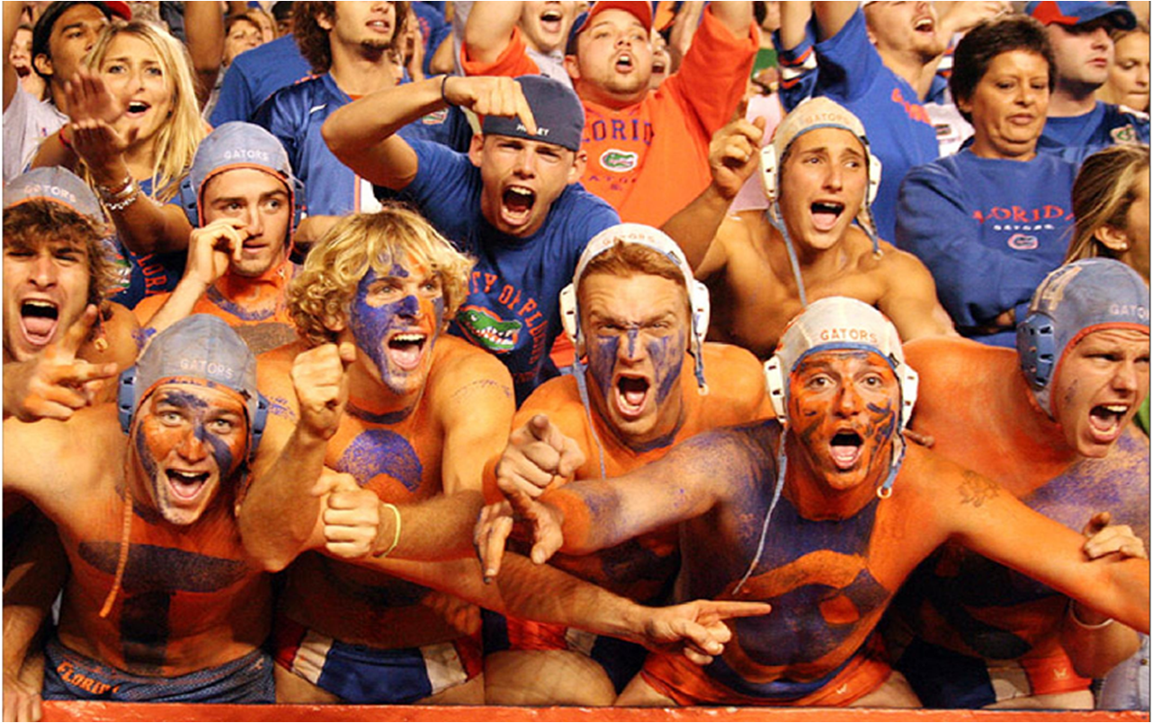
Fans
Hard core fans even see the team as an extension of themselves! Fans get into fights with opposing fans.
Testosterone levels can rise or fall 25% due to win or loss

