Slide 2
Something about the nature of science…
Model: Possible explanation of a phenomenon
Ex. Atomic model
Law: Proven experimentally
Ex. Snell’s Law, Newton’s Laws
Theory: Considered true, but cannot be tested in every possible case
Ex. Molecular Theory

Slide 3
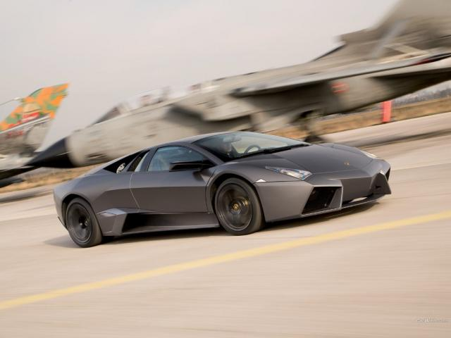
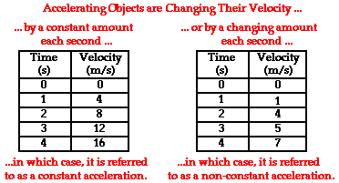
Something about the nature of physics…
Four modes of representation:
1. Visual
2. Numeric
3. Graphical
4. Symbolic

