Slide 1
Populations

Slide 2
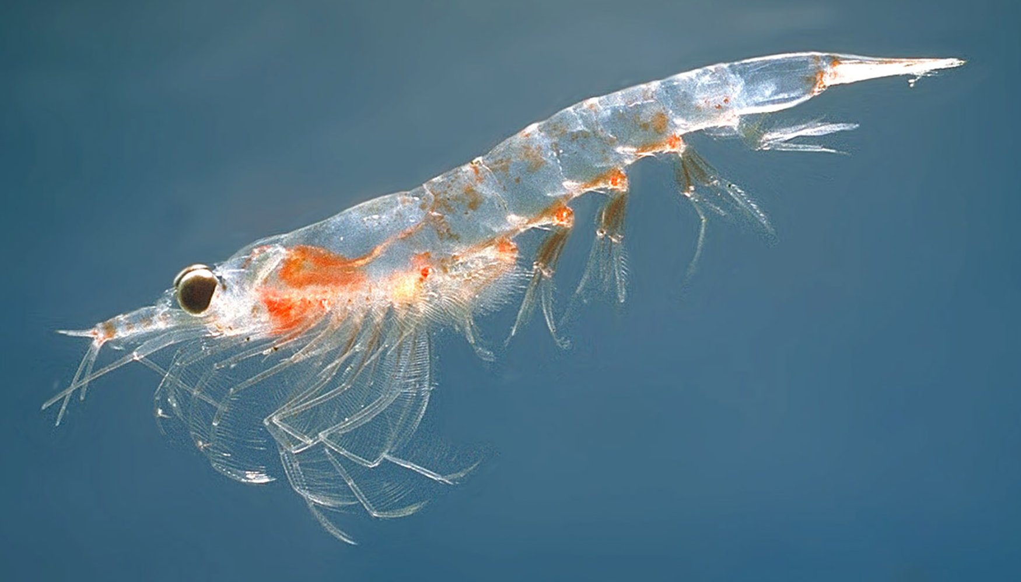
Definitions
Biosphere: Encompasses all ecosystems. Any place on earth (land and water) and within the atmosphere that life can exist.
Biomass: The cumulation of all living matter within the ecosystem. Biomass is measured in weight or by area (eg. Square meter)

Slide 3
Population: A group of organisms of the same species that exist in the same place at the same time. Members of a population can join or leave. A population can change with birth and death, immigration and emigration.
Carrying Capacity: The optimum number of organisms of a particular species that can be supported by a particular environment. Populations usually fluctuate below the carrying capacity.

Slide 4
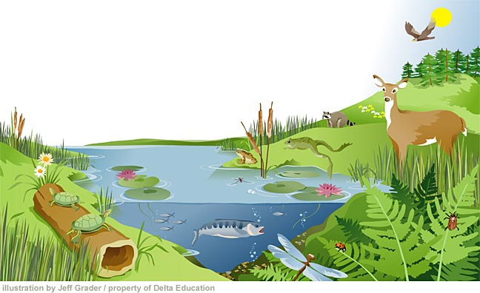
Community: All the different populations of different species living in an ecosystem.
Biotic Factors: Living parts of an ecosystem
Abiotic Factors: Non-Living parts of an ecosystem

Slide 5
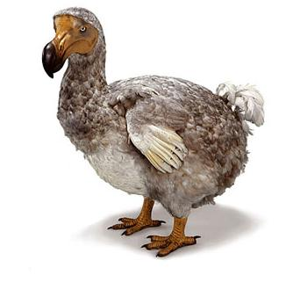
What are some factors that limit population growth?
Space
Food Supply
Competition
Climate
Natural Disasters
Human Interference
Hunting

Slide 6
Density-Dependent vs Density-Independent
Density Dependent
Affects the population according to its size
Density Independent
Affects all populations regardless of their size

Slide 7
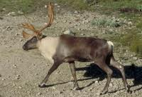
Woodland Caribou
Two species of caribou live in Manitoba:
Barren-Ground Caribou which live in the tundra region of northern Manitoba – herds consist of thousands of animals
Woodland Caribou which live in the boreal region – ranges consist of less than 150 animals
Up until the mid 1900’s Woodland Caribou inhabited all of Manitoba’s boreal forests and into Minnesota.
Caribou are very sensitive to environmental change and as a result, their range is becoming smaller.

Slide 8
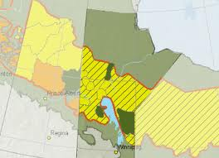
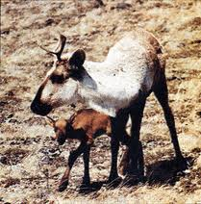
Distribution Across Manitoba
Fun Fact: Unlike other members of the deer family, both male and female caribou have antlers!

Slide 9
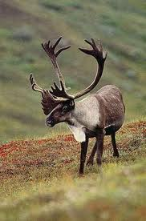
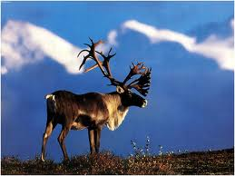
What are the Woodland Caribou up to?
While Barren-Ground Caribou migrate thousands of kilometers each year, Woodland Caribou generally stay in one area and rarely exceed migration patterns over 80km.
The woodland caribou use different habitats in the forest throughout the year. All areas used by a certain group is called the range.
In Manitoba, there are ten distinct ranges (groups) of Woodland Caribou

Slide 10
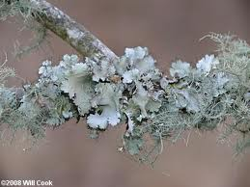
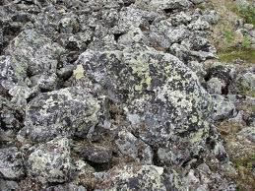
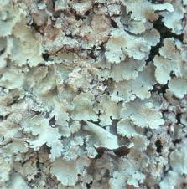
In the winter, Caribou depend on abundant supplies of lichen as their main food source. Lichens grow in rocky, pine-rich habitats.
In the summer, caribou stay close to wetlands and lakes. Caribou are excellent swimmers.
Woodland caribou avoid predators by keeping small ranges and remaining wide-spread across an area.

Slide 11
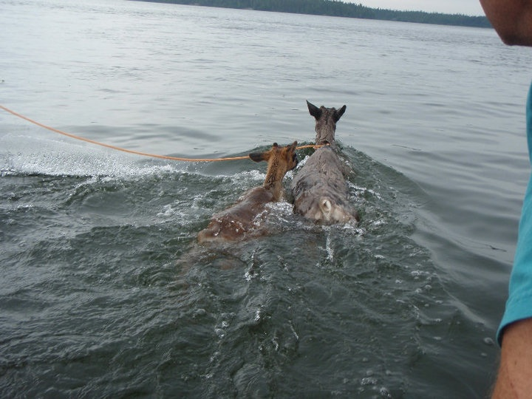

Slide 12
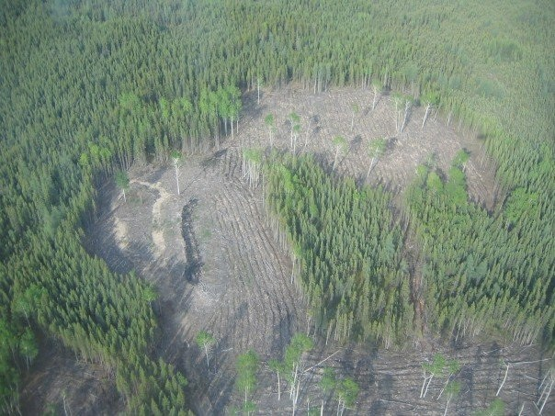
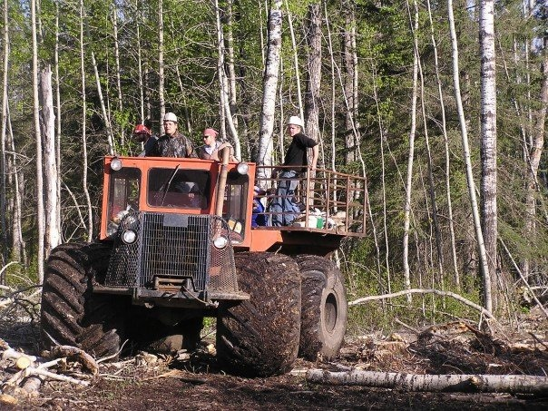
Density-Independent Factors
Deforestation: While clear-cuts are excellent habitat for lichens to grow, noise from machinery in the summer and winter can drive the Caribou away

Slide 13
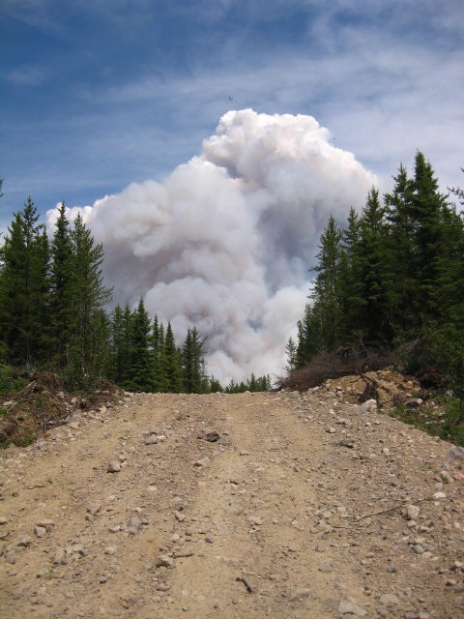
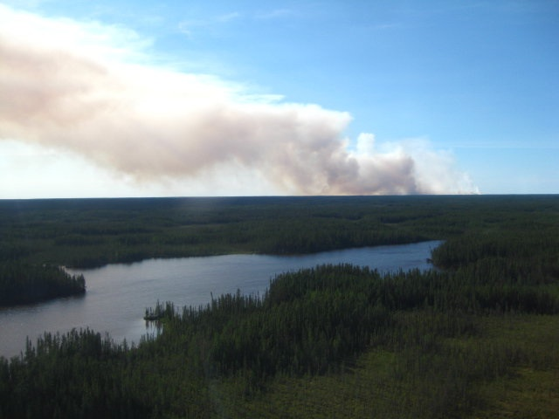
Forest Fires: Large burning forest fires can kill caribou, but what’s even worse is the loss of habitat. Studies have shown that caribou will avoid a burnt area for close to 70 years!
This fire started on June 16, 2010 and covered 55 727 hectares. That’s almost the size of Winnipeg! It burned for over two weeks

Slide 14
http://www.gov.mb.ca/conservation/fire/Fire-Maps/nw-firedisplay.jpg

Slide 15
Graphing a population
Biologists use population graphs to monitor the changes in a certain species.
In studying these graphs we must consider both density-dependent and density-independent variables.
Population graphs – especially those considering predator-prey relationships – often have a continuous fluctuating and decreasing pattern.

Slide 19
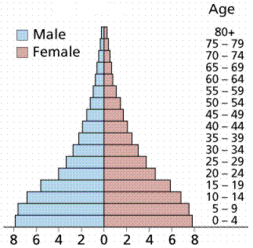
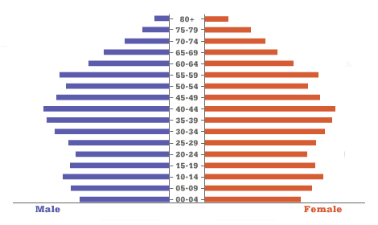
Histograms
A population histogram allows us to compare sexes and age groups within a population.
These histograms can help us to determine trends in a population.

Slide 20
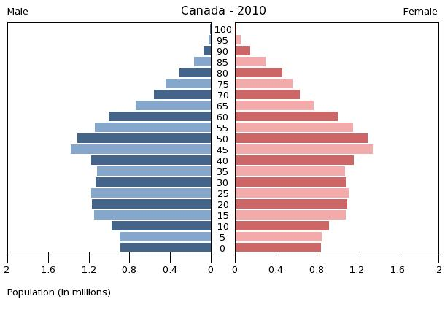

Slide 21
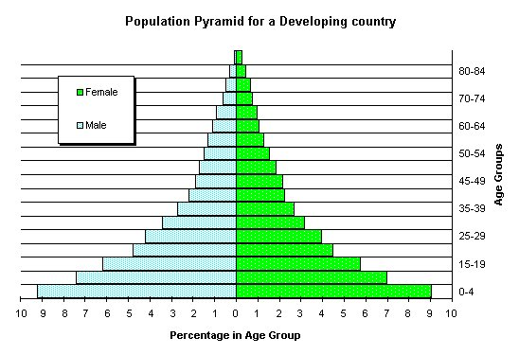

Slide 22
Population Growth
Open population: Population in which organisms are free to come and go (immigrate and emigrate)
ex: Forest, lake
Closed population: Population in which immigration or emigration cannot naturally occur.
Ex: aquarium
Natality: Births
Mortality: Deaths

Slide 23
Population Growth
In order to determine the change in a population over time, scientists use a population growth formula.
This formula considers 4 factors:
Births
Deaths
Immigration
Emigration

Slide 24
Population Growth Formula
Population Growth=(births+immigration)-(deaths+emigration)
PG = (B+I) – (D+E)
Remember: This formula gives us the population GROWTH or change in population. The formula does NOT determine the actual number of organisms in the population.

Slide 25
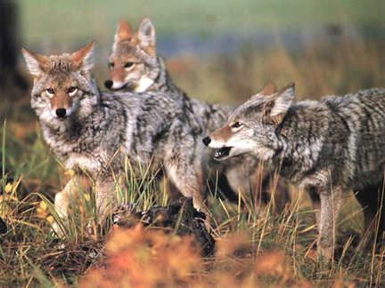
Let’s try one out!
It has been a cold year and a population of coyotes is feeling the effects. During the year 12 pups were born, but 5 died. 9 coyotes left the population to find more food, however, the pack welcomed 2 from the pack across the river. What was the population growth?
PG = (B+I) – (D+E)
PG = (12+2) – (5+9)
PG = (14) – (14)
PG = 0

Slide 26
On Your Own..
Biologists want to study population growth of ladybugs in two weeks. In a small ecosystem 137 ladybugs die and 213 are born. 187 leave the population and 98 immigrate in. What is the change in population?
In a flock of migrating Canada Geese, 28 decide to stop in California and not come home. 9 die on the hard journey home. Back in Winnipeg, 36 new chicks are born and 12 join in from another flock. What is the population growth at the end of the season?
If we know that the population of geese was 96 at the beginning of the migration, what is the population now?

Slide 27
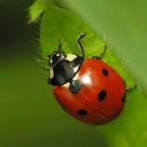
Ladybugs
Biologists want to study population growth of ladybugs in two weeks. In a small ecosystem 137 ladybugs die and 213 are born. 187 leave the population and 98 immigrate in. What is the change in population?
PG = (B+I) – (D+E)
PG = (213+98) – (137+187)
PG = (311) – (324)
PG = -13
There are 13 less ladybugs in the population after two weeks

Slide 28
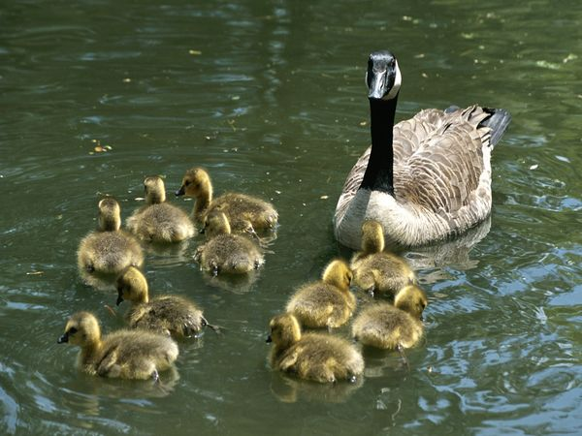
Canada Geese
In a flock of migrating Canada Geese, 28 decide to stop in California and not come home. 9 die on the hard journey home. Back in Winnipeg, 36 new chicks are born and 12 join in from another flock. What is the population growth at the end of the season?
PG = (B+I) – (D+E)
PG = (36+12) – (9+28)
PG = (48) – (37)
PG = 11
There are 11 more geese at the end of the season
If we know that the population of geese was 96 at the beginning of the migration, what is the population now?
96 + 11 = 107

Slide 30
Review
What conclusions can
we make about the
population of Brazil?

Slide 31
What do you
Notice here?

Slide 32
Population Growth Formula
A herd of Barren-Ground caribou move into Manitoba from Nunavut. While traveling thousands of kilometers, 86 die from the harsh conditions. 47 decide the competition for food is too tough so they go find another herd. Once in Manitoba, the herd is joined by 28 new Caribou and 94 calves are born. What is the population growth?
If the herd had 846 Caribou to begin with, what is the new population?
Population Growth=(births+immigration)-(deaths+emigration)
PG = (B+I) – (D+E)

Slide 33
PG = (B+I) – (D+E)
PG = (94+28) – (86+47)
PG = (122) – (133)
PG = -11
There are 11 less caribou in the population
846 -11= 835
The new population number is 835

