Slide 1
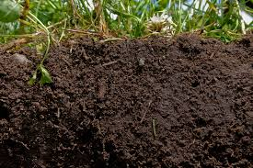
Soil Analysis

Slide 2
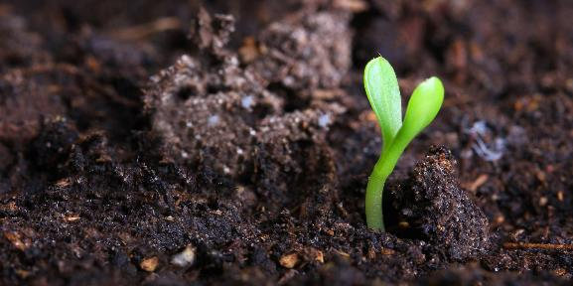
Soil is…
The loose top layer of our planet’s crust. It is dirt or earth on which plant life can grow.

Slide 3
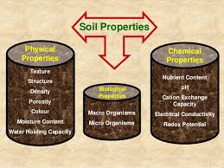
Properties of soil
pH
Capillary action
Water holding ability (drainage)
nutrients

Slide 4
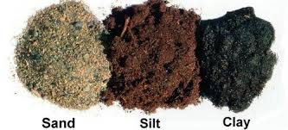
Types of Soil
Soil scientists describe soil types by how much sand, silt and clay are present. This is called texture.

Slide 5
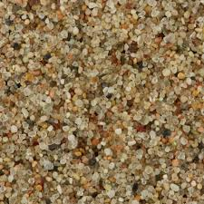
Sand
The largest particle in soil
Feels sharp and rough
Doesn’t hold many nutrients

Slide 6
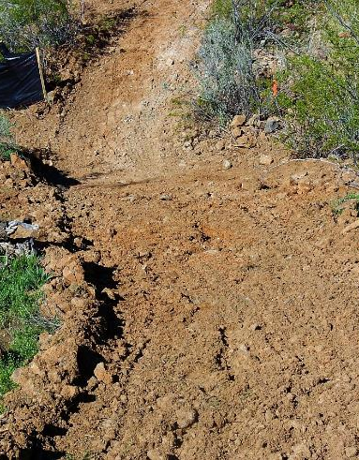
Silt
Size is between sand and clay
Feels smooth and powdery
When wet it feels smooth but not sticky

Slide 7
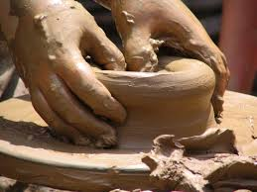
Clay
The smallest of soil particles
Smooth when dry and sticky when wet
Soils high in clay are called heavy soils
Can hold a lot of nutrients but doesn’t let air and water through it well

Slide 8
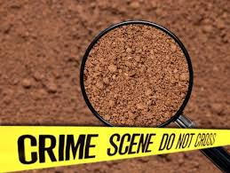
How does soil help us solve crimes?

Slide 9
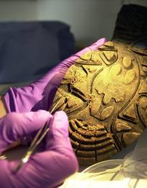
1. Location
Since there are many different types of soil, investigators can test things like pH, or capillary action from a soil sample on the body to match a murder with a location.

Slide 10
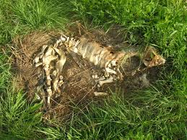
2. Time of Death
Dead bodies leak fatty acids. The types and amounts of these acids reveal the time of death

Slide 11
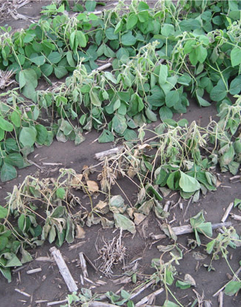
3. Removed body
Since the acids left behind by a body kill plant life (for up to 2 years), a sort of ‘footprint’ of no growth is left on the scene.

