Slide 1
The Cycles of Life
Can you name them?
Hint: There’s four

Slide 2
While energy flows in a one-way direction through an ecosystem, nutrients are recycled over and over again.
Biogeochemical cycles are the processes by which nutrients move through organisms and the environment.
* Bio = life, Geo = Earth*
You may be familiar with the water cycle in which water moves from the Earth’s atmosphere to the surface (precipitation) and back to the atmosphere again (evaporation).

Slide 3
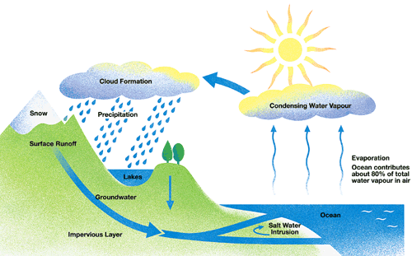

Slide 4
The Carbon Cycle
The process by which carbon moves through an ecosystem is called the carbon cycle.
Producers such as green plants and algae take in a carbon containing compound known as carbon dioxide from the atmosphere. The chemical formula for carbon is CO₂.

Slide 5
During photosynthesis, the energy of the sun is used to convert carbon dioxide into glucose, a type of organic compound. Plants then change glucose into other types of carbon compounds.
When animals eat plants and algae, the carbon compounds are converted into glucose.
Glucose is then converted into carbon dioxide and energy in a process known as cellular respiration. The energy is used by organisms for growth, movement, reproduction, excreting wastes, digesting food, and so on.

Slide 6
The carbon dioxide is released into the atmosphere, and the cycle continues.
Fossil fuels are carbon-containing compounds such as gasoline, coal, and natural gas that are burned by humans to produce energy.
The combustion of fossil fuels also releases carbon dioxide into the Earth’s atmosphere. The energy is then used to heat our homes and run our automobiles and factories.

Slide 7
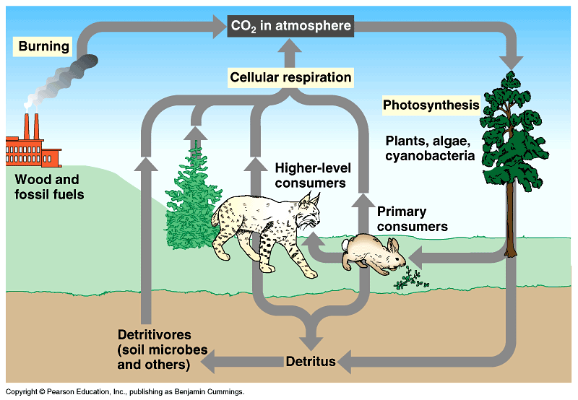

Slide 8
The Oxygen Cycle
The oxygen cycle, which moves through an ecosystem, is closely linked to the carbon cycle. Plants use water during photosynthesis and release oxygen gas into the atmosphere.
The chemical formula for oxygen gas is O₂.
Organisms then use the oxygen gas during cellular respiration and release water into the atmosphere.
The cycle continues as plants produce oxygen during photosynthesis, which is then used by organisms in cellular respiration.

Slide 9
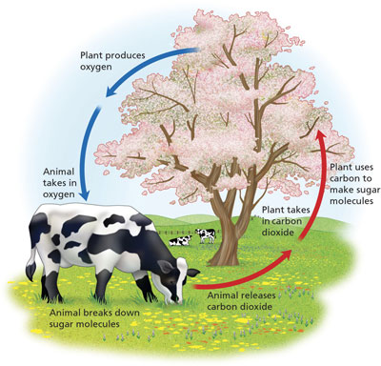

Slide 10

What might happen if there is an increase of carbon in the atmosphere?

Slide 11
The carbon cycle with and without humans
In 1750, WITHOUT industry & vehicles, there was around 280 CO₂ molecules in every million air molecules
In 2007, WITH industry & vehicles, there is now 380 CO₂ molecules in every million air molecules (35% increase)
Atmosphere
Atmosphere
Burning
Photosynthesis
Photosynthesis
Plants
Respiration
Plants
Respiration
Industry &
Vehicles
Animals
Animals
Decomposition
Pumping
Decomposition
Fossil
Fuels
Organic
Material
Fossil
Fuels
Organic
Material

Slide 12

What’s in a tree?
One large tree can:
Lift up to 4000 litres of water from the ground and release it into the air
Absorb as many as 7000 dust particles per litre of air
Provide a day’s oxygen for up to four people
Trees reduce carbon by:
Storing carbon in trunks, branches, leaves and roots
Absorbing carbon produced by vehicles
Storing carbon in wood-based by-products (paper, lumber, furniture)
Remove carbon through photosynthesis

Slide 13
Carbon Footprint Calculator
http://www.carbonfootprint.com/calculator.aspx

Slide 14
Nitrogen Cycle
Nitrogen is an important nutrient found in all living things and is used to build proteins.
The process by which nitrogen moves through an ecosystem is known as the nitrogen cycle.
While nitrogen gas makes up about 78% of Earth’s atmosphere, most living things cannot use it in this form. The chemical formula for nitrogen gas is N₂
Certain bacteria can change nitrogen gas into nitrate (NO₃) and ammonia (NH₃)
These are nitrogen compounds that plants can use. The process is known as nitrogen fixation and only occurs in the roots of legume plants.

Slide 15
Legumes include clover, alfalfa, beans, and peas. All plants then convert the nitrate and ammonia produced in the roots of legumes into a variety of plant proteins. When animals eat plants, they convert plant protein into animal protein.
For example, when you eat bread, beans, pasta, or any other foods containing plant matter, your body converts the protein into muscle, hair, fingernails and other animal proteins.
When you eat meat, your body also converts the animal proteins into the proteins your body needs.

Slide 16
When plants and animals die, decomposers break down their remains. Some bacteria and fungi cause proteins to decay into nitrate and ammonia, which can be taken up again by plants and used to make proteins.
Other bacteria will convert nitrate and ammonia back into nitrogen gas in a process known as denitrification.
This process also occurs when bacteria convert animal waste (ex. sewage) and plant waste (ex. Dead leaves) into nitrogen gas.
Chemists have created an industrial process that creates nitrates and ammonia in factories. This industrial nitrogen fixation produces fertilizer that farmers use to grow better crops.

Slide 17
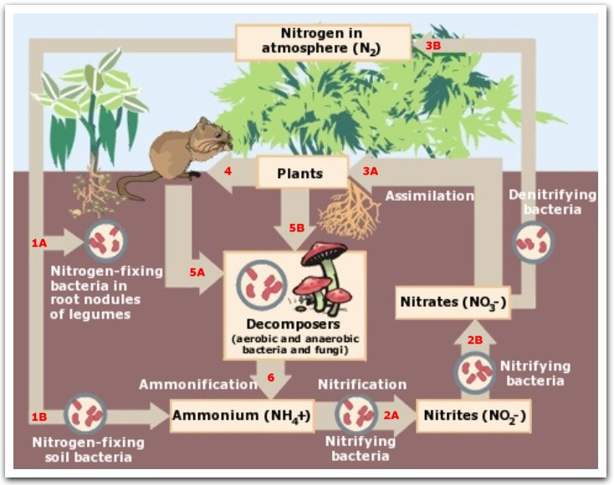

Slide 18
Re-cap: Five Main Steps
When a plant or animal dies or excretes wastes, nitrogen compounds pass into the soil or water
Bacteria in the soil or water break down these nitrogen compounds into ammonia (which is toxic)
Some of the ammonia is converted by bacteria into ammonium ions which some plants can use directly
Nitrifying bacteria in the soil convert ammonium ions into nitrite ions which are taken up by plants
Nitrite ions are converted into nitrate ions, dissolved in water, and taken up by plant roots.

Slide 19
Disturbing the Cycles!

Slide 20
Human Impact on the Carbon Cycle
Humans interfere by releasing carbon faster than normal by:
  Mining and burning fossil fuels
  Burning forests, which produces more carbon dioxide and kills trees and green plants which absorb carbon dioxide.
  Therefore: CO₂ levels are rising

Slide 21


Impacting the Nitrogen Cycle
When crops are harvested, nitrogen is harvested with them. Fields are left with less. Fertilizers restore nitrogen to the land, but this comes with a cost.

Slide 22
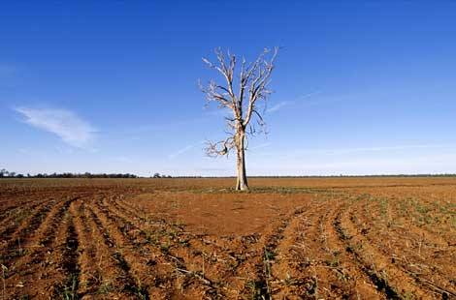
1. Nitrates (NO3) increase acidity of soil which effects baceteria living in it. The pH of soil should be neutral (7), but can go down to 6 due to fertilizers so crops don’t grow as well.

Slide 23
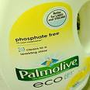

Water runoff carries field nutrients to streams and lakes which causes the algae in the water to grow rapidly (algal bloom). When the algae die, bacteria use oxygen to decompose them.
Since the bacteria have so much food, they thrive and use up all the oxygen in the water so there is none left for the fish and other animals. When the fish die, bacteria thrive even more and use more oxygen!

Slide 24
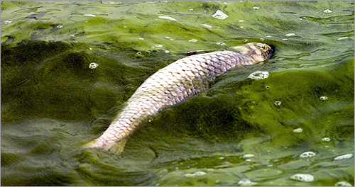
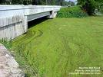
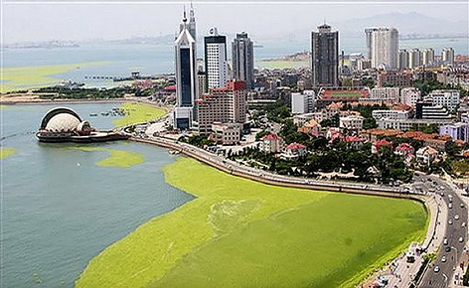

Slide 25
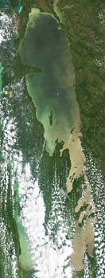
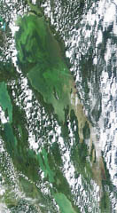
Recognize This?
Lake Winnipeg
June 28, 2010 – No signs of algae
July 20, 2010 – Algae bloom clearly
visible in north basin.
Lake Winnipeg is the tenth largest
freshwater lake in the world and it is in trouble!
http://www.youtube.com/watch?v=7AFOfpbkTdg

Slide 26
What can we do?
Restore your shoreline to a more natural state.
Ensure that your septic system is in good shape, with no leaks.
Do not flush anything down your toilet that shouldn’t ‘traditionally’ go down a toilet, such as medications and chemicals.
Reduce your use of phosphorus.
Keep large animals, such as cattle, away from shorelines of streams, rivers and lakes.
Reduce the impacts caused by your recreational activities

Slide 27
3. Certain bacteria convert nitrates (NO3) to nitrites (NO2), which are dangerous to humans and animals because they attach to hemoglobin in the blood so that it cannot transport oxygen.
Normally stomach acids kill these bacteria, but infants do not have strong acids in the stomachs so the nitrites are absorbed by the blood.

Slide 28

Acid Rain
The combustion of fossil fuels produces: SO2 and NOx, which combine with water in the atmosphere to produce acids.
Acids return to Earth through precipitation. SO2 and NOx can also combine with water in dew, lakes, and even your lungs!

Slide 29
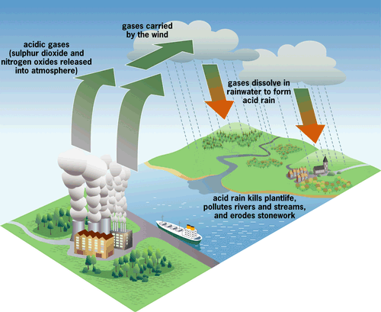

Slide 30

Effects of Acid Rain
Dissolve marble statues and damage buildings
Corrodes metal, and dulls car finishes
Causes respiratory problems like asthma and bronchitis
Causes irritation to eyes and skin
Damages plants and makes them more susceptible to infection
Decreases pH of soil and water, which kills bacteria, fish, and plants

