Slide 1
Urine Analysis

Slide 2
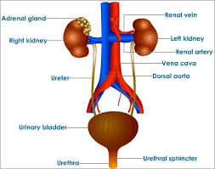
The Excretory System

Slide 3
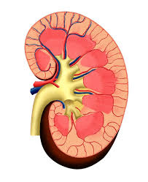
Kidney
Kidneys are located on each side of the spine, just below the ribs.
They eliminate nitrogenous and other dissolved wastes.
Kidneys are about the size of a small fist and are filled with many tiny filters called nephrons
Nephrons filter 180 L of blood every 24 hours!

Slide 4
Characteristics of Urine
Amber or yellow (darker if not drinking enough water)
Transparent (cloudy if left standing)
Acidic (unless vegetarian – alkaline)
95% water

Slide 5
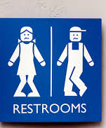
How much urine is produced in a day?
1.5 L, but it depends how much water you drink. Bladder can hold 200-400mL

Slide 6
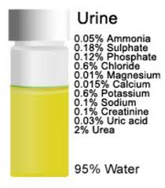
What is urine?
Water (from fluid intake)
Uric acid (from protein breakdown)
Sulphates
Creatine (from muscle action)
Ammonia (smell)
Salts (from food)

Slide 7
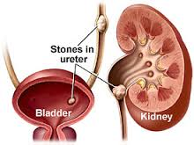
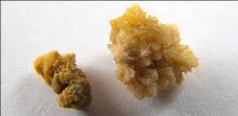
Why do doctors test urine?
Glucose = diabetes or liver disease
Uric acid crystals = kidney stones
Blood = urinary tract infection

