Slide 1
Work and Energy

Slide 2
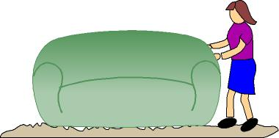
Work and Energy
Energy can be given to, or taken from an object by doing work. To understand this better, let’s brainstorm some types of energy…

Slide 3
Types of Energy
Brainstorm!

Slide 4
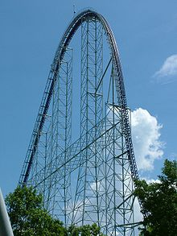
Potential Energy (Gravitational)
An object has energy because of how high it is.
‘Stored energy’

Slide 5
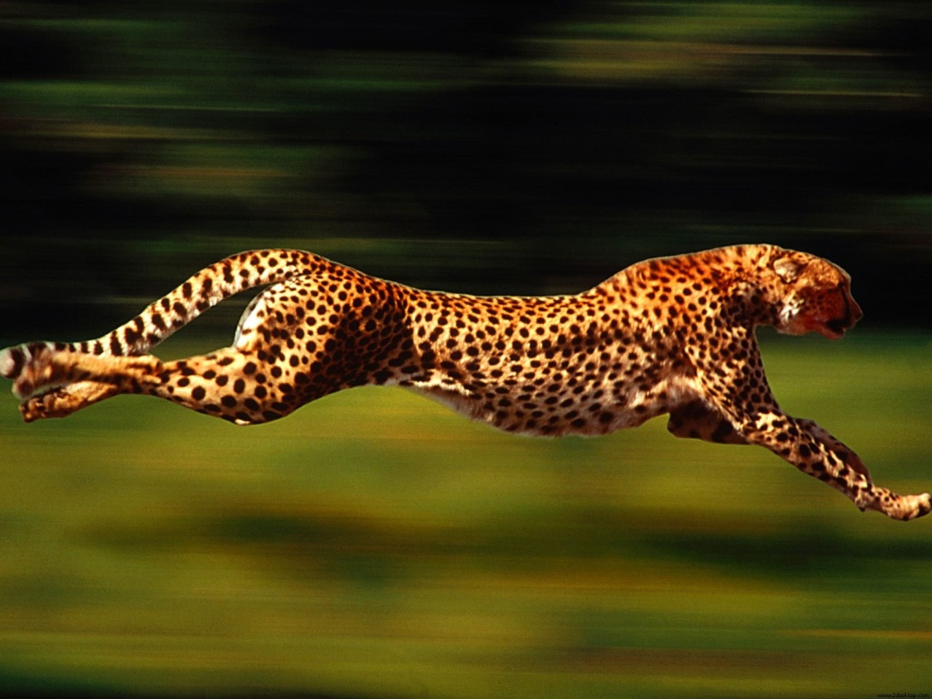
Kinetic Energy
An object has energy because it is moving.

Slide 6
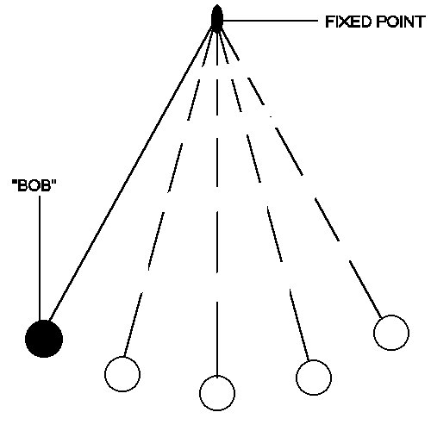
Pendulum
Energy is constantly changing from potential to kinetic to potential…

Slide 7
Ok, let’s try some examples:
1. A student lifting a box of books
2. An athlete releasing a curling rock, which then slides on the ice to a stop.
3. Robin Hood firing an arrow into a target.
4. A car driving.
5. Turning on a stove and boiling a pot of water.

Slide 8
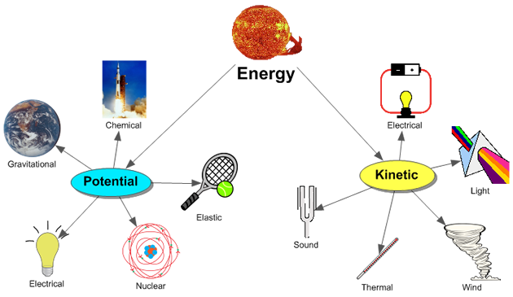
All the Energy!!!
When you really think about all the energy moving from place to place in every second of your day, it’s mind boggling!! Positive and negative work is constantly being done!!
* Remember that since work is a scalar, positive and negative work simply means that work is being gained or lost, it does not have a direction.

Slide 9
Videos
The story of kinetic and potential energy
Potential energy: Wile E Coyote & Roadrunner
GED Physics: Kinetic and potential energy in a roller coaster

Slide 10
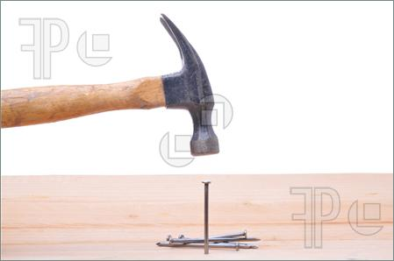
Work-Energy Theorem
Energy is usually defined as the ability to do work. A moving object can do work on another object it strikes. A moving object can do work on another object it strikes. A flying cannonball does work on a brick wall it knocks down or a hammer does work on a nail it strikes.

Slide 11
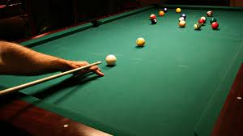
Work-Energy Theorem
That is, a moving object exerts a force on a second object and moves it through a distance. An object in motion has the ability to do work and thus can be said to have energy.

Slide 12
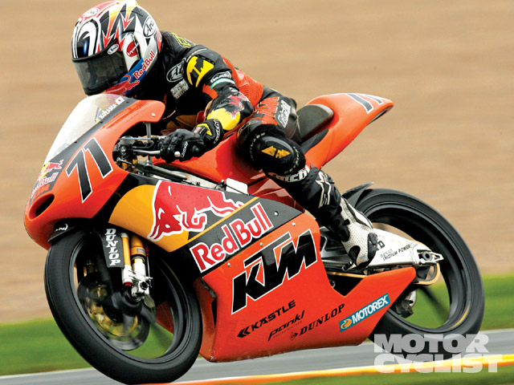
Kinetic Energy
Kinetic energy can be defined as:

Slide 13
Some really neat algebra…
Therefore, the net work done on an object is equal to its change in KE:

Slide 14
Sample Problems
1. A 145 g baseball is thrown with a speed of 25 m/s.
A) What is its KE?
B) How much work was done to reach this speed starting from rest?
2. How much work is required to accelerate a 1000 kg car from 20 m/s to 30 m/s?

Slide 15
Gravitational Potential Energy

