Slide 1
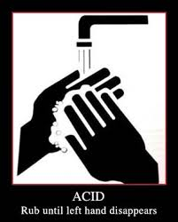
Acids & Bases
Outcome:
S2-2-08 Experiment to classify acids and bases using their characteristic properties. Include: pH, indicators, reactivity with metals.

Slide 2
What the heck are acids & bases?
Acids and bases are two groups of compounds that have their own characteristic formulas and chemical Properties, especially when they are dissolved in water.
Acids and bases will normally be dissolved in water, and therefore have the _{(aq)} subscript after their formula indicating an AQUEOUS SOLUTION.
Substances that are acidic or basic usually contain either hydrogen ions (H⁺) or Hydroxide ions (OH⁻)
How acidic or basic a substance is can be measured using the pH scale – more on this later…

Slide 3
Definition of Acids and Bases:
All substances will fall into one of three categories:
Acid
Base
Neutral (neither)
Chemists have come up with many ways of classifying substances into these categories. We will use the simplest definition…
Acids
Are ionic compounds that contain Hydrogen ions (H⁺), or release hydrogen ions in water.
The hydrogen ions are what give acids their distinct properties.
Bases
Are ionic compounds that contain Hydroxide ions (OH⁻), or release hydroxide ions in water.
The hydroxide ions are what give bases their distinct properties.

Slide 4
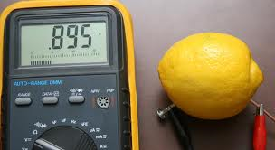
Properties of Acids:
Acids typically have the following properties:
CONTAIN HYDROGEN IONS (H⁺)
When acids are dissolved in water they release H+ ions.
These ions are what give acids their properties
ex) HCl → H⁺ + Cl⁻
CONDUCT ELECTRICITY
Since there are ions (charges), acids can carry electricity

Slide 5
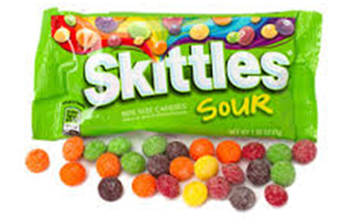
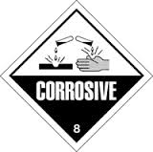
Properties of acids:
SOUr taste
Think of citrus juices (orange or grapefruit), they all contain CItric acid.
Sour candies are also coated in citric acid
Corrosive
Will react with most metals
Burn the skin – like battery acid or bee stings

Slide 6
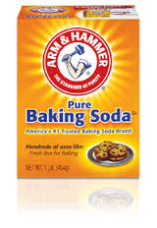
Properties of Bases:
Bases:
Bases typically have the following properties:
CONTAIN HYDROXIDE IONS (OH⁻)
When Bases are dissolved in water they release OH- ions.
These ions are what give basess their properties
ex) NaOH → Na⁺ + OH⁻
CONDUCT ELECTRICITY
Since there are ions (charges), bases can also carry electricity
Bitter taste
Think of soaps, baking soda

Slide 7
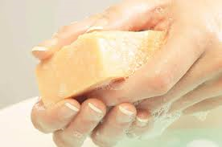
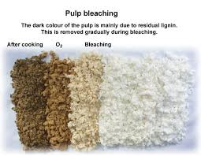
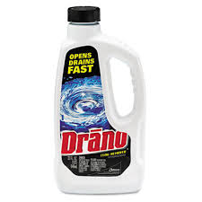
Properties of bases:
FEEL SLIPPERY
Think of soaps, which are made by reacting a base with fats.
Caustic
Reacts with living tissue to break it down.
Used in drain cleaners and papermaking.

Slide 8
Some Common Acids:
Formula | Name | Found In
H₂SO_{4(aq)} | Sulfuric Acid | Car batteries
HCl_{(aq)} | Hydrochloric Acid | Stomach acid
H₂CO_{3(aq)} | Carbonic Acid | Soft drinks
H₃PO_{4(aq)} | Phosphoric Acid | Soft drinks
HNO_{3(aq)} | Nitric Acid | Explosives
HC₂H₃O_{2(aq)} | Acetic Acid | Vinegar
HC₆H₇O_{7(aq)} | Citric Acid | Oranges, lemons
HC₃H₅O_{3(aq)} | Lactic Acid | Sour milk, muscle fatigue
HC₉H₇O_{4(aq)} | Acetylsalicylic Acid | Aspirin

Slide 9
Some Common Bases:
Formula | Name | Found In
NaOH(aq) | Sodium hydroxide | Drain cleaner
KOH(aq) | Potassium hydroxide | Soap, cosmetics
Al(OH)₃(aq) | Aluminum hydroxide | Antacids
NH₄OH(aq) | Ammonium Hydroxide | Ammonia, windex

Slide 10
Testing acids and bases…
There are different ways to test how acidic or basic (alkaline) a substance is…
pH – “The Power of Hydrogen”
A scale that goes from 0 – 14 that tells us how acidic or basic (alkaline) a substance is:

Slide 11
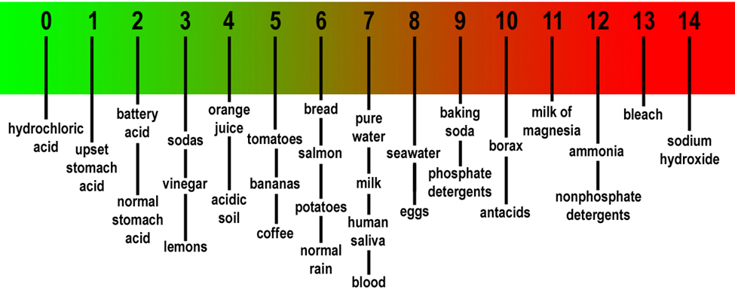
Testing acids and bases…
pH – “The Power of Hydrogen”
Here are some examples of everyday substances and their approximate pH:

Slide 12
Testing acids and bases…
pH – “The Power of Hydrogen”
Every unit of pH represents a difference of a factor of 10, for example:
Vinegar (pH ≈ 3) is ten times more acidic than orange juice (pH ≈ 4)
Battery acid (pH ≈ 2) is 10x more acidic than vinegar (pH ≈ 3) and 100x more acidic than orange juice (pH ≈ 4)
pH can be measured using a pH meter or certain indicators.

Slide 13
Testing acids and bases…
Indicators
Indicators are substances that change colour when in the presence of an acid or a base.
Some common indicators are listed in the table below:
A bunch of indicators can be mixed together to make universal indicator, which will change different colours at a range of different pH values.
Indicator | Acid Colour | Base Colour
Litmus | Red | Blue
Phenolphthalein (feeno-thay-leen) | Colourless | Pink
Methyl orange | Orange | Yellow
Bromothymol blue | Light yellow | Blue
Red Cabbage Juice | Pink | Blue

Slide 14
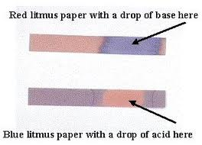
Testing acids and bases…
Litmus paper
Paper that has been soaked in litmus indicator.
Cannot tell you a pH value, but will tell you if a solution is acidic or basic.
Comes in two colours – blue and red.
Blue litmus turns red in acid
Red litmus turns blue in base

Slide 15
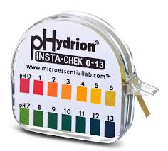
Testing acids and bases…
pH paper
Paper that has been soaked in universal indicator.
You can dip the paper in the solution and compare the resulting colour with the chart on the container to get an approximate pH

