Slide 1
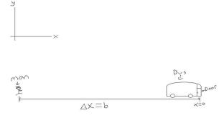
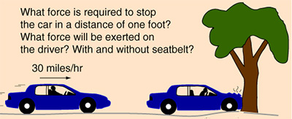
Mechanics
Kinematics –How things move
Dynamics – Why things move

Slide 2
Scalar vs Vector
Scalars
Vectors

Slide 3
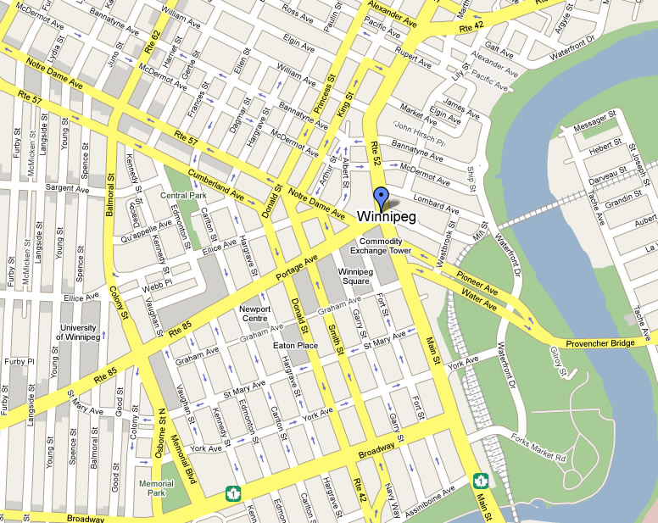
Example Vector Problem
Ms Werner travels from portage and main to memorial park. She drives 1000 m west on portage and then 600 m south on memorial. What distance did she travel? What is her displacement?

Slide 4
Method 1: Scale Diagram

Slide 5
Method 2: Trig

Slide 6
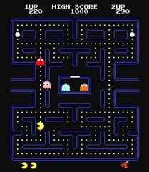
Pac Man Problem (2 methods: Scale Diagram vs Pythagoras)
What is the shortest distance from Pac Man to the top right pellet?
What is the displacement from Pac Man to the top right pellet?

Slide 7
Lab: Vector Journey
Group 1: Gym to Office. Rm 209 to Computer Lab.
Group 2: Vending machine to Resource Room. Cafeteria to Gym.
Group 3: Library to Cafeteria. Computer lab to Ms Brophy’s office.
Group 4: Vending Machine to Cafeteria. Gym to ITC display case.
Group 5: Pay phone to vending machine. Cafeteria to vending machine.
Group 6: Girl’s bathroom to PDHS room. Front of Office to GW gym door.

