Slide 1
Projectile Motion

Slide 2
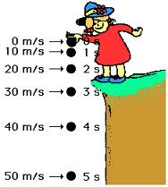
Consider a falling object…
It experiences a constant acceleration of 9.8 m/s²

Slide 3
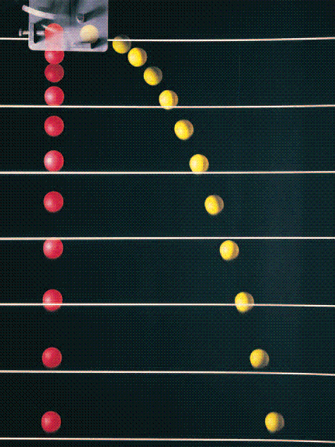
Consider if it got pushed forward..
Y: still constant acceleration down (force of gravity)
X: no force – therefore no acceleration (constant velocity)

Slide 4
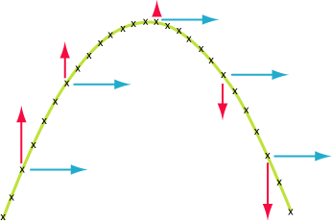
For an object in projectile motion..
Horizontal velocity never changes
Vertical acceleration is always 9.8 m/s² down

Slide 5
Example
A cannon fires a shell at 275 m/s at an angle of elevation of 35º. Calculate:
The horizontal and vertical components of the shell’s velocity at firing.
The time for the shell to reach the top of its flight.
The total time of flight.
The range of the shell.

